Slide 1
An NSS Audio-Visual
Library Presentation
Caves of the Guadalupe
US Forest Service (1980)
(adapted for the NSS in 1993)
S206 117 Slides 2/13/2021

Slide 2
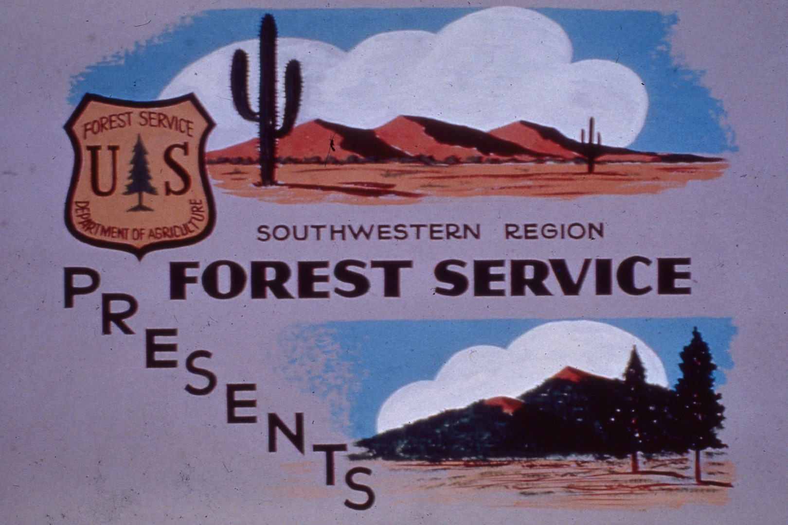

Slide 3
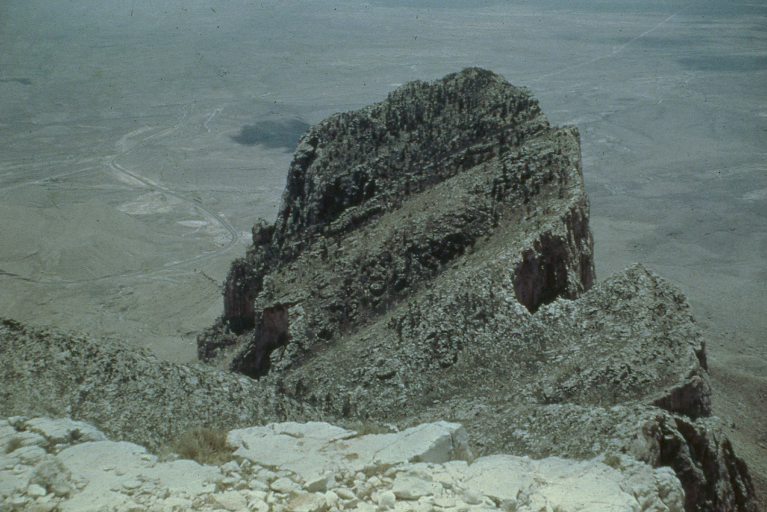
Notes:
The Guadalupe Mountains of New Mexico hold some of the wildest and most picturesque country remaining in the state.

Slide 4
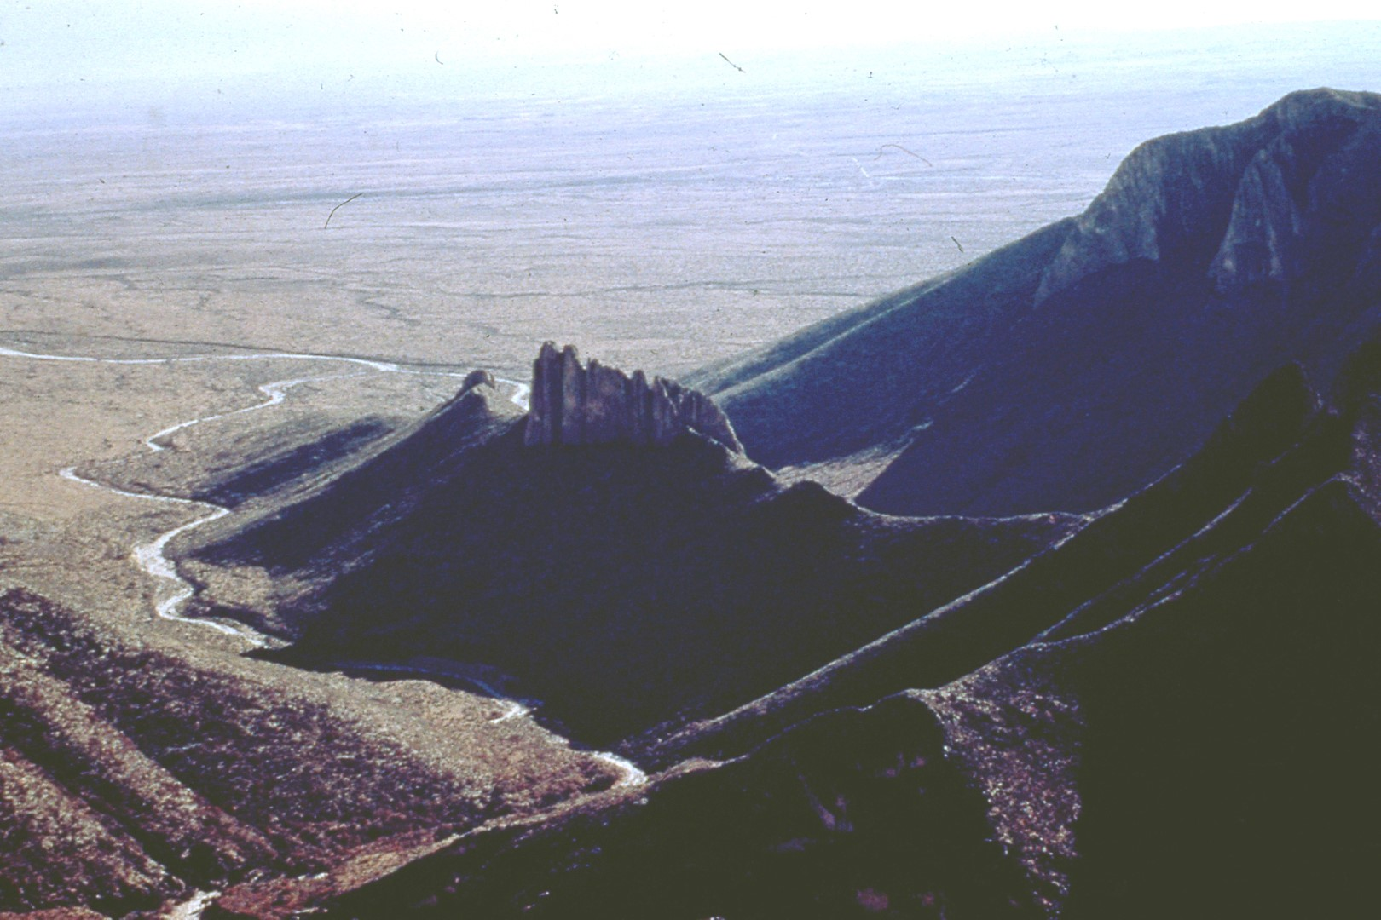
Notes:
A very large portion of these mountains, approximately 290,000 acres, is included in the Guadalupe Mountains Ranger District of the Lincoln National Forest.

Slide 5
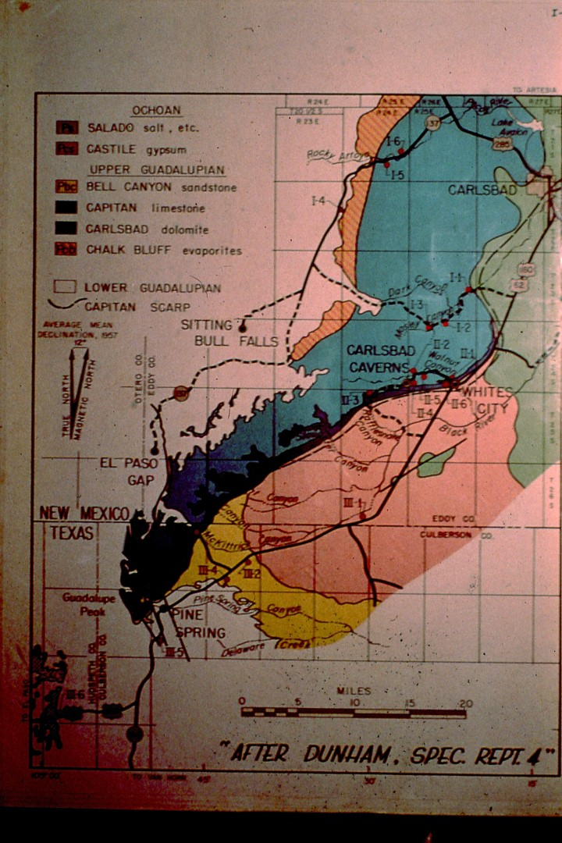
Notes:
The Ranger District borders the northern boundary of Guadalupe Mountain National Park of Texas along the Texas-New Mexico state line and the western boundary of Carlsbad Caverns National Park.

Slide 6
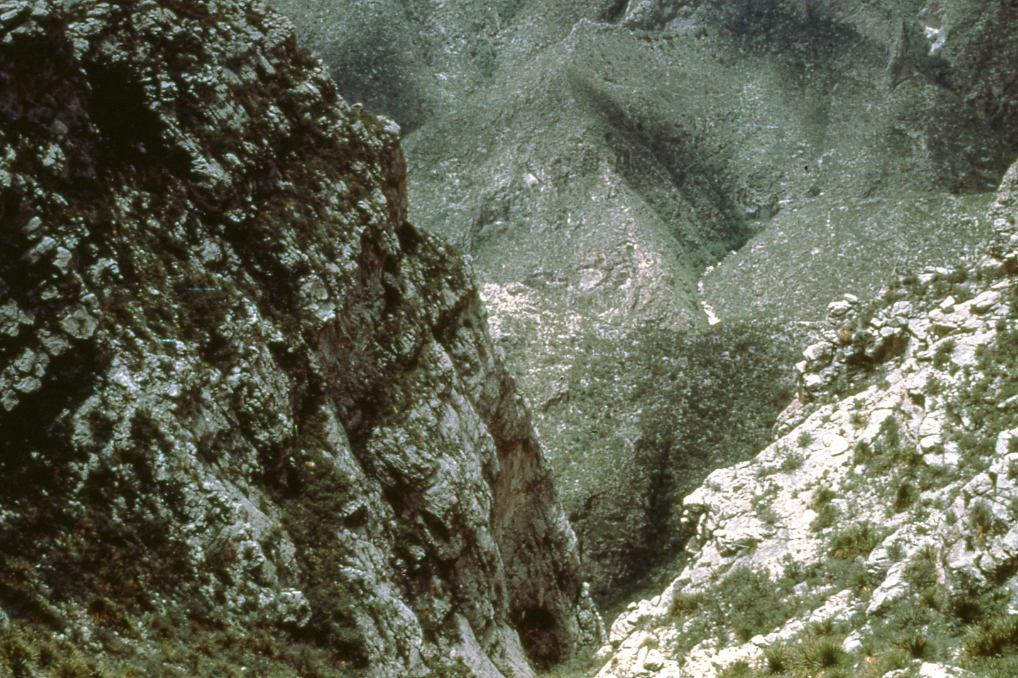
Notes:
The southern most tip of the Guadalupe Ranger District includes approximately 35 square miles of rugged mountains and canyons …

Slide 7
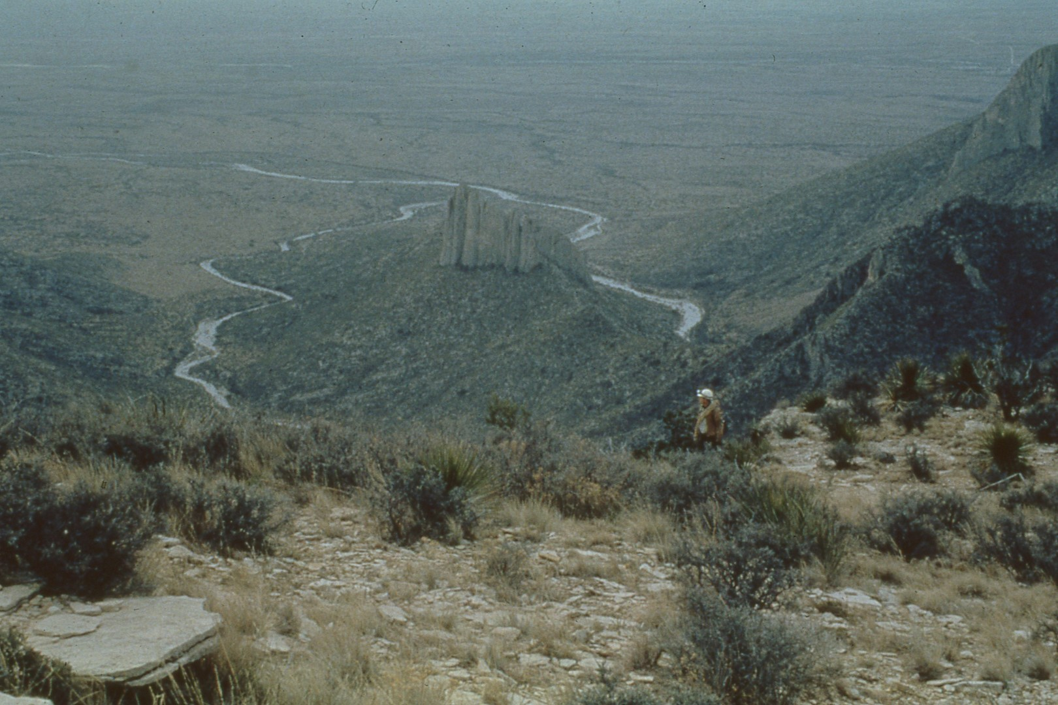
Notes:
extending from the mouth of Gunsight Canyon at an elevation of 4,800 feet lo Dark Canyon lookout tower at an elevation of 6,950 feet.

Slide 8
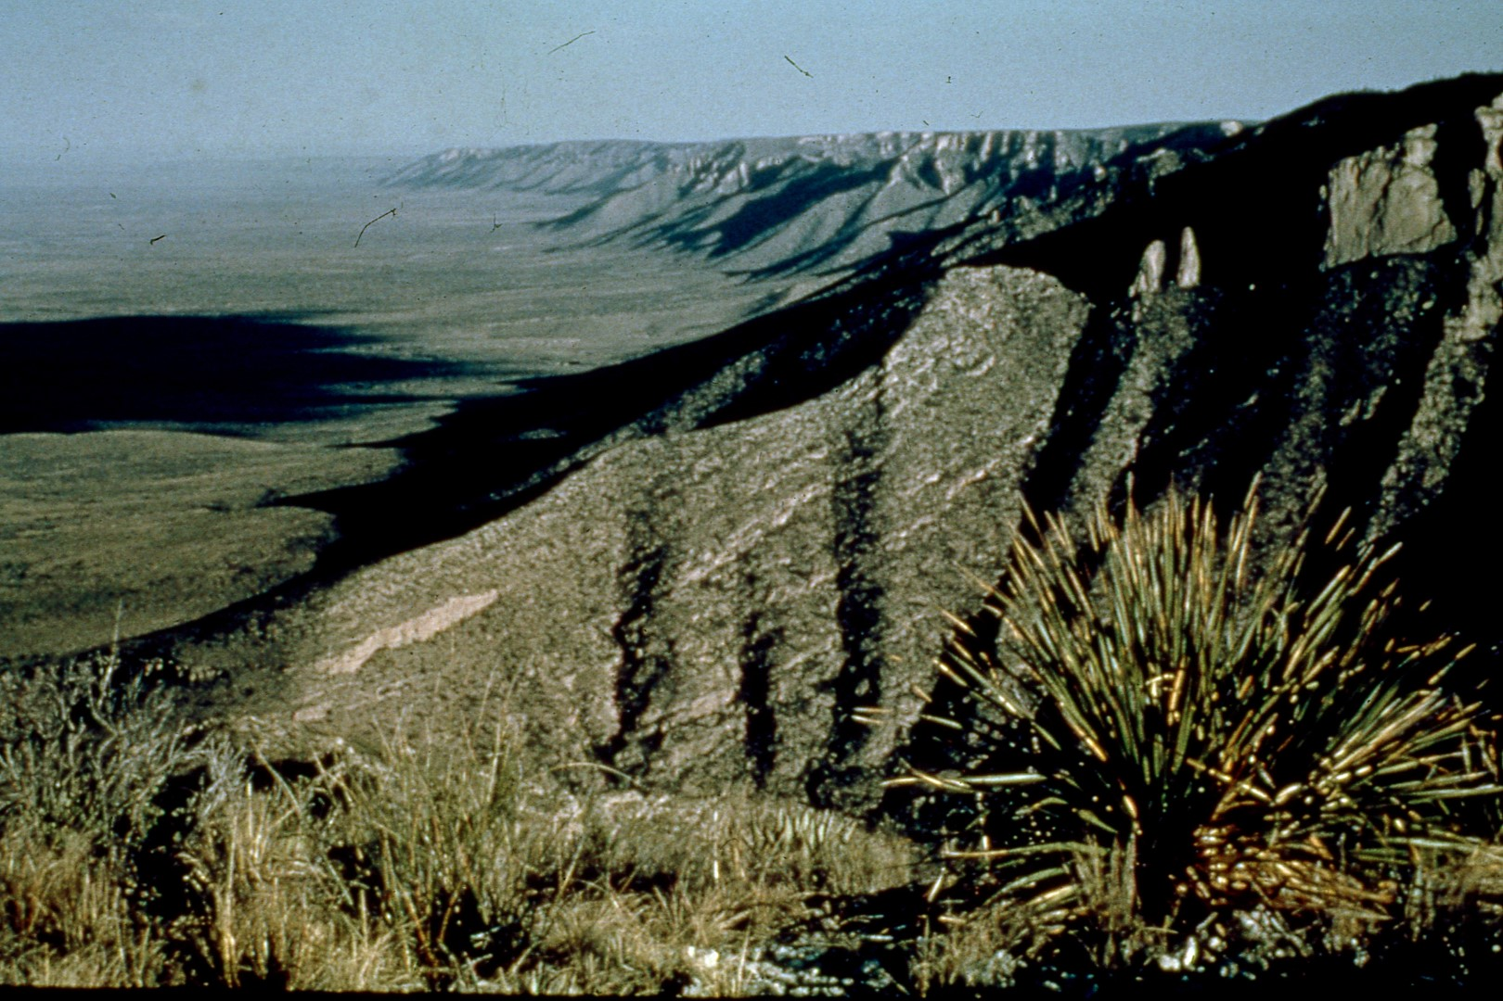
Notes:
The reef, a limestone formation, was created from lime secreting algae …

Slide 9
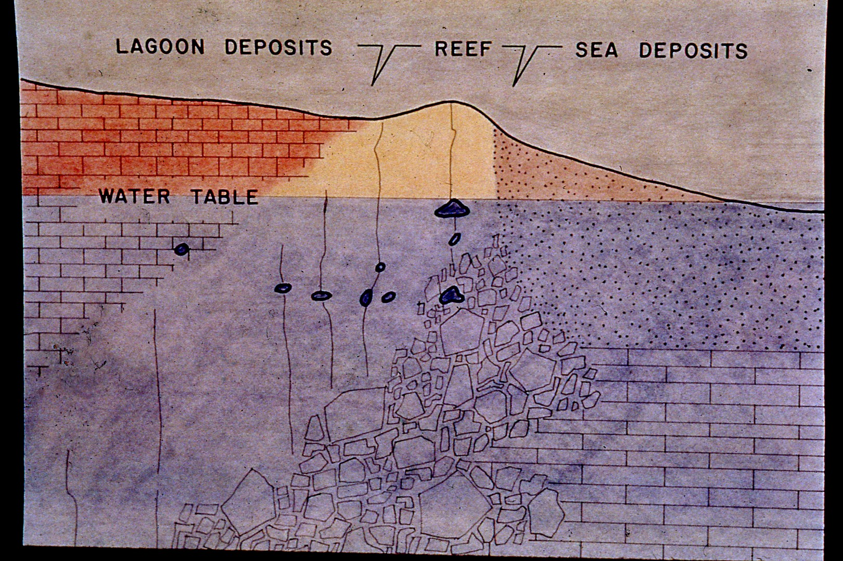
Notes:
when this area was covered by a shallow sea.

Slide 10
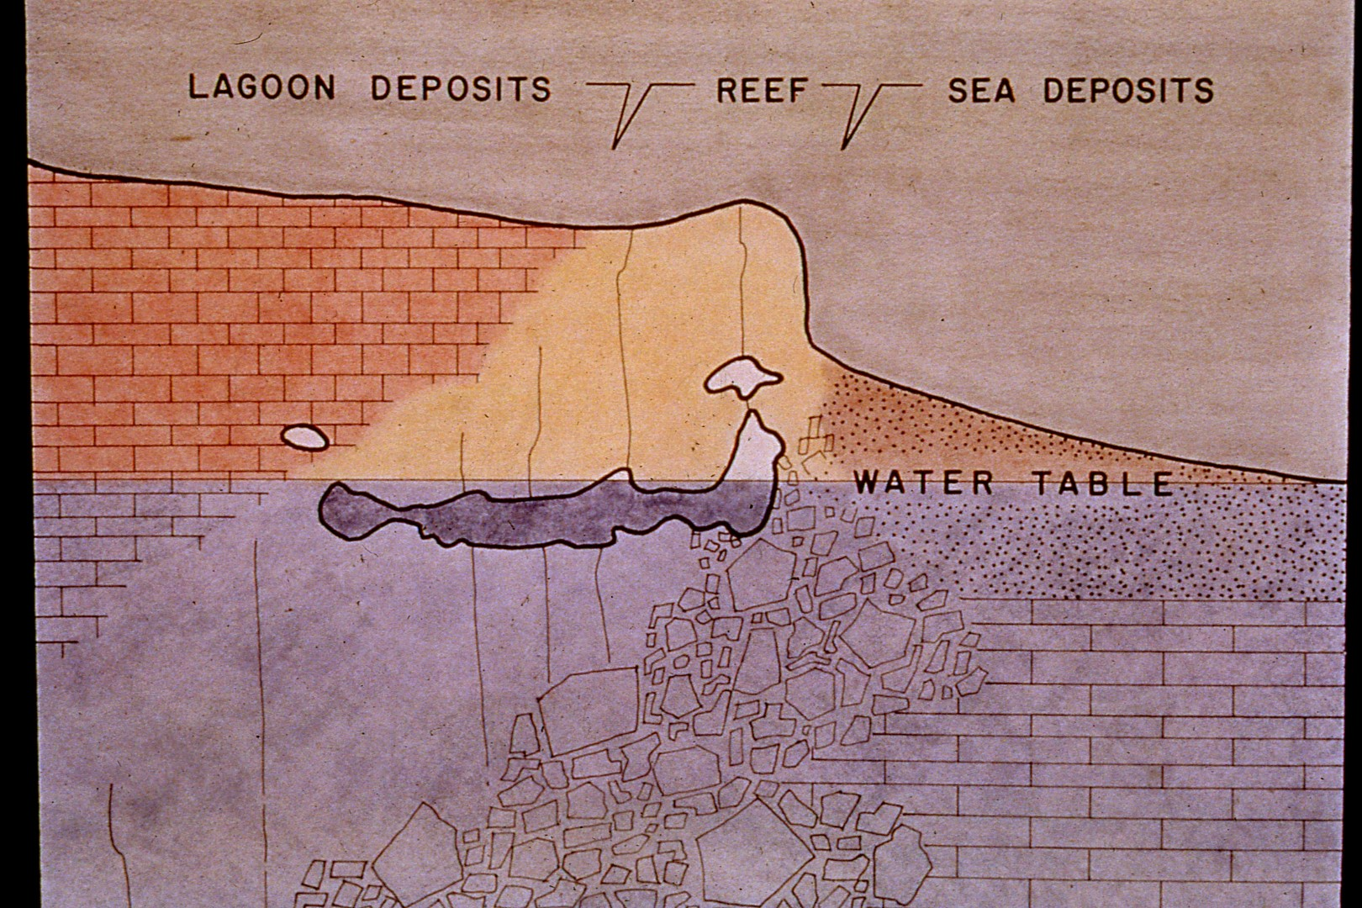
Notes:
The sea later dissipated, and the reef uplifted.

Slide 11
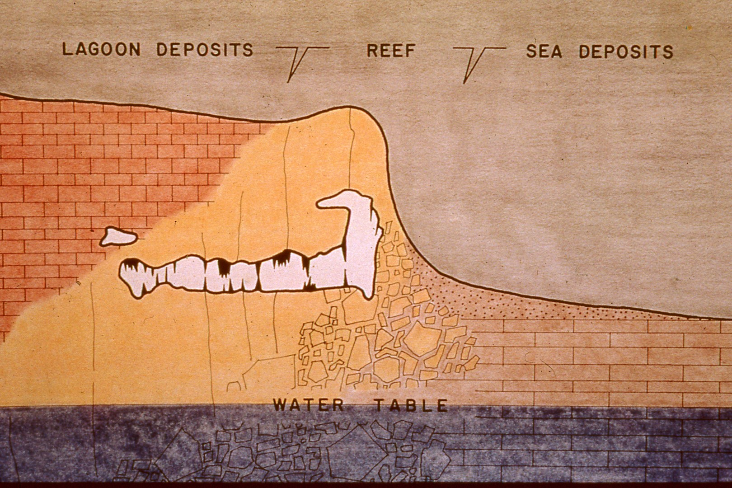
Notes:
The result being extensive cavern systems formed within the reef with magnificent and carious formations, …

Slide 12
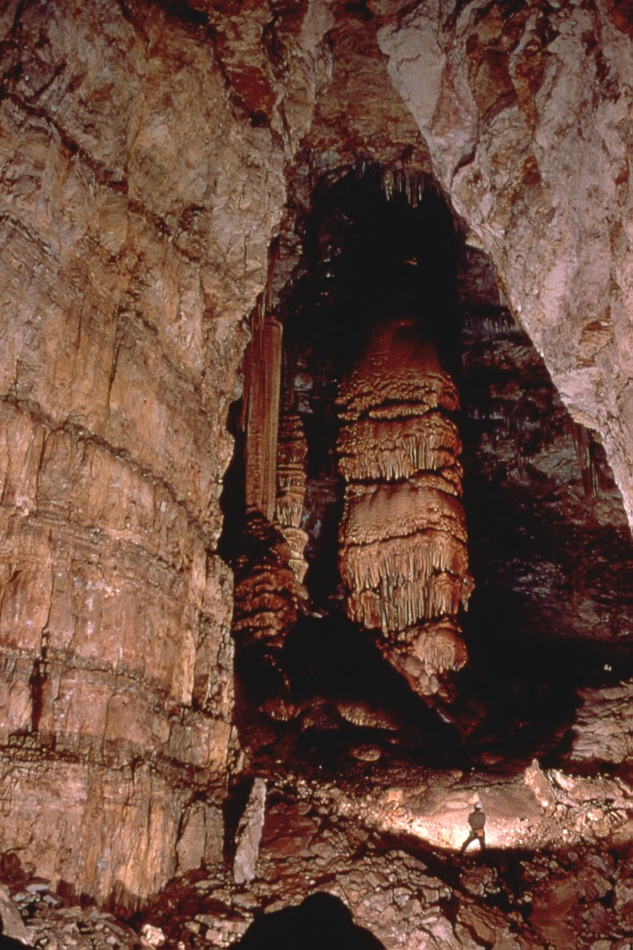
Notes:
including a diverse array of some of the largest known …

Slide 13
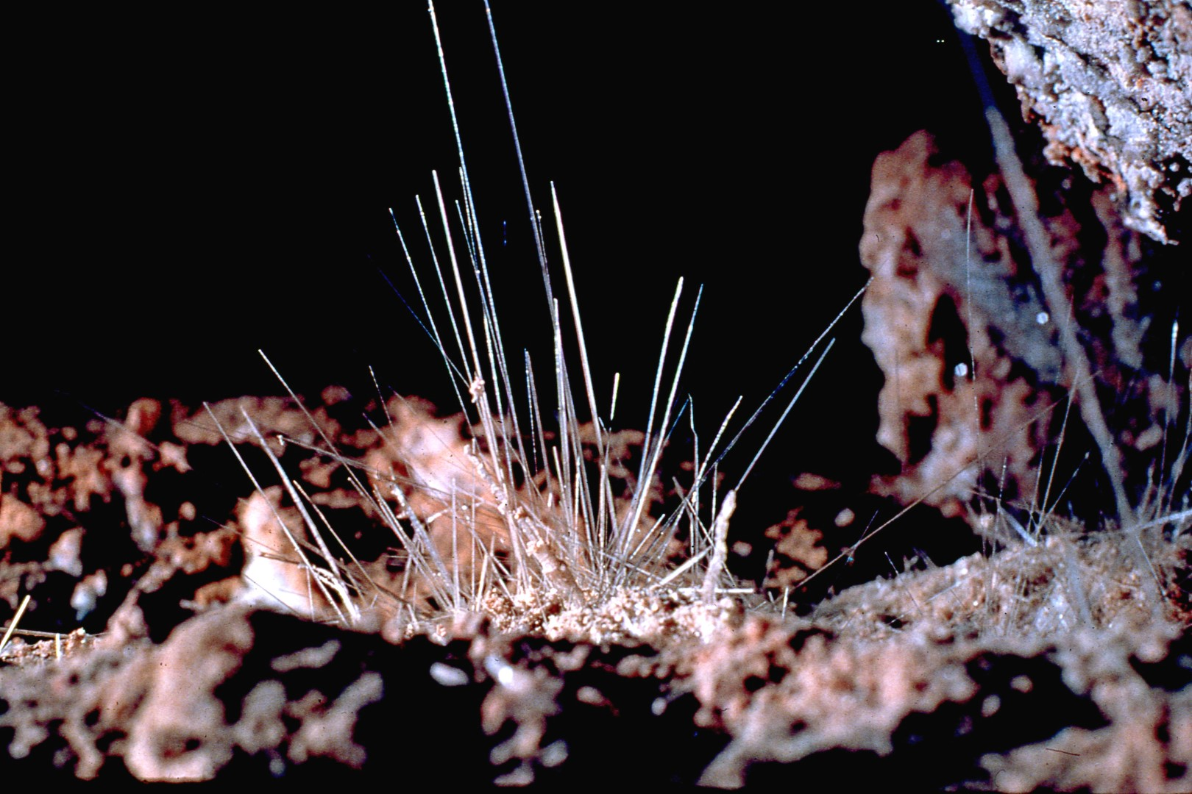
Notes:
to the most delicate and rare crystalline formations found in any cave in the world.

Slide 14
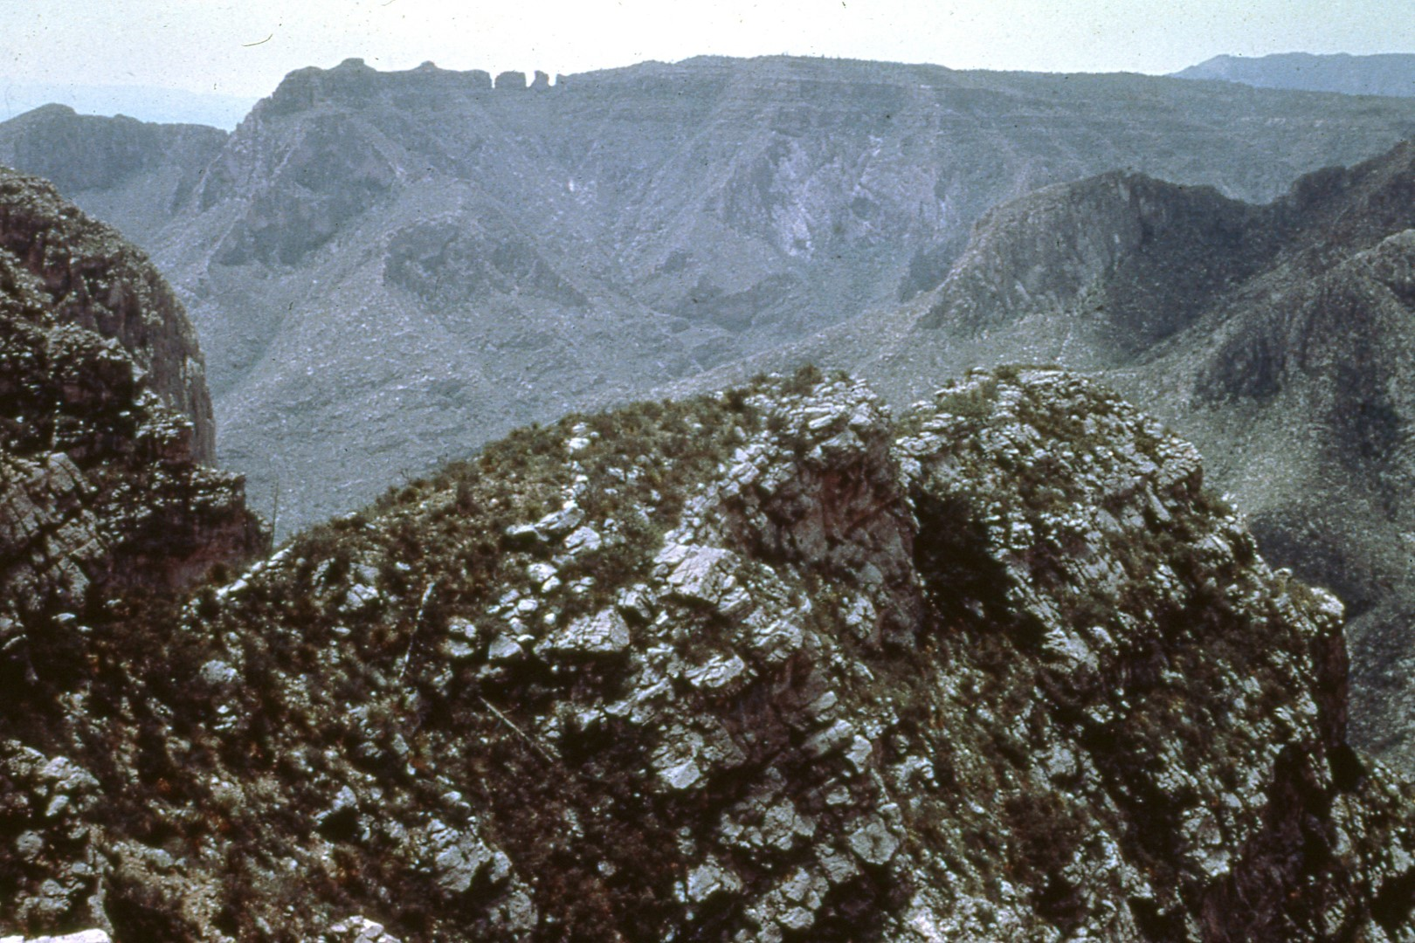
Notes:
As illustrated in this photograph taken from the north rim of Big Canyon the trek to most caverns in the Guadalupes is no easy task.

Slide 15
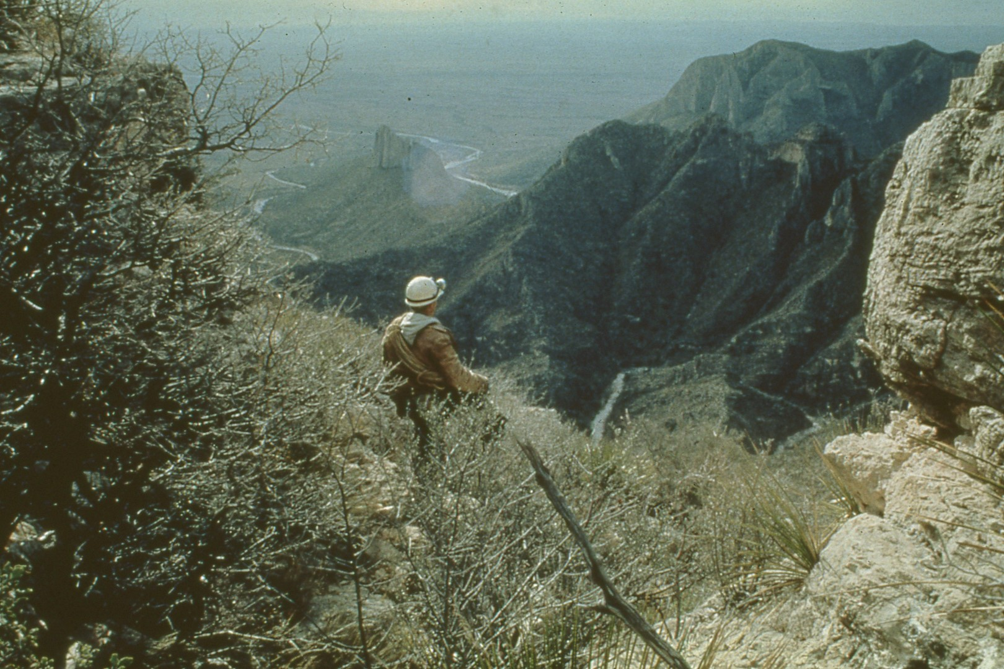
Notes:
The hike is often lengthy and difficult due to the rugged terrain.

Slide 16
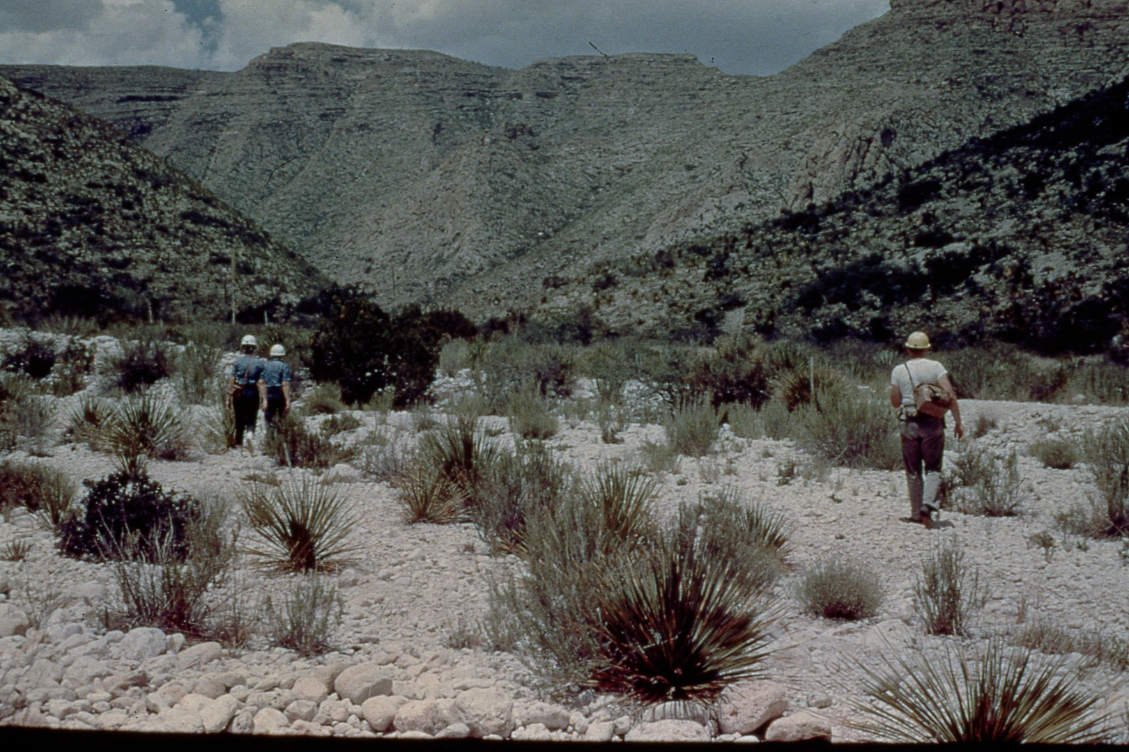
Notes:
In addition, equipment such as rope, climbing gear, helmets, and an abundance of water must be carried the length of the journey.

Slide 17
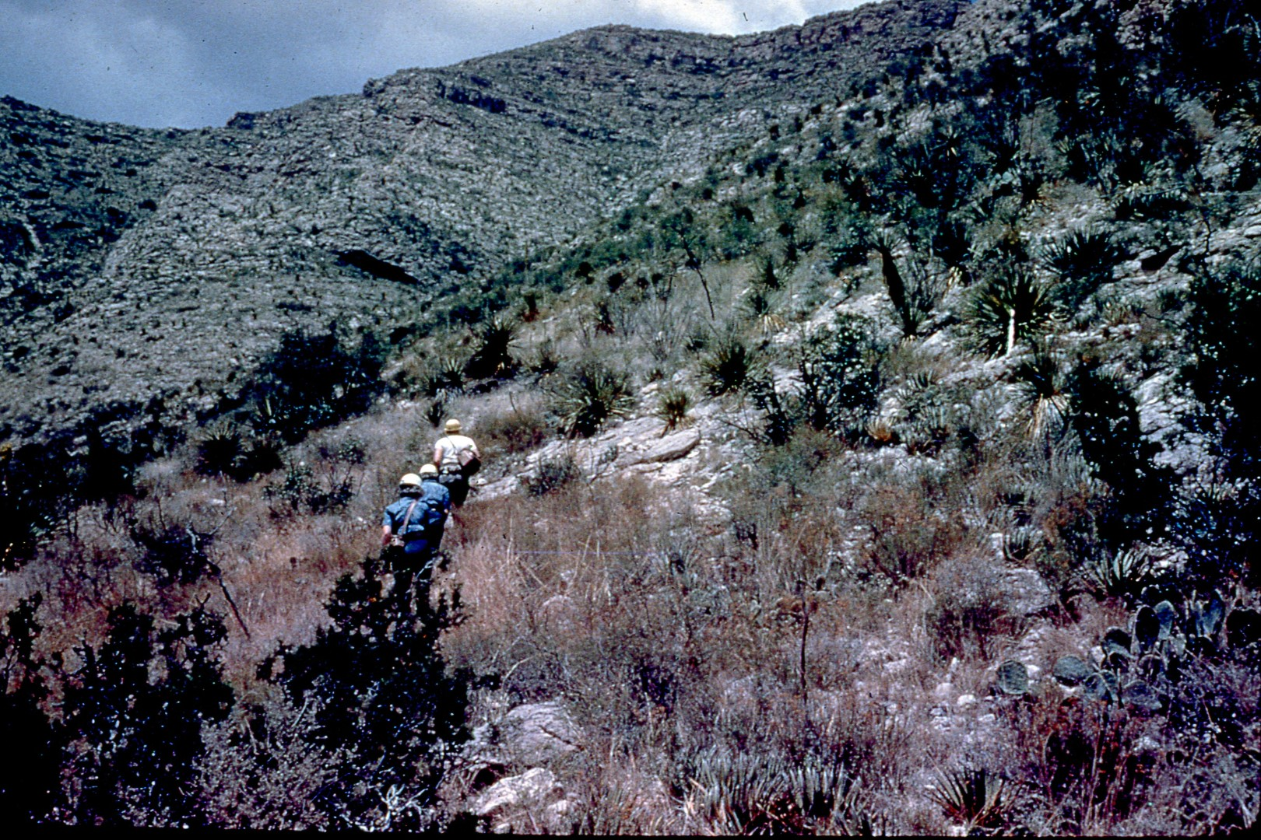
Notes:
A caver must be prepared to traverse the distance along ridges, through canyons, ascending and descending steep walls for several miles.

Slide 18
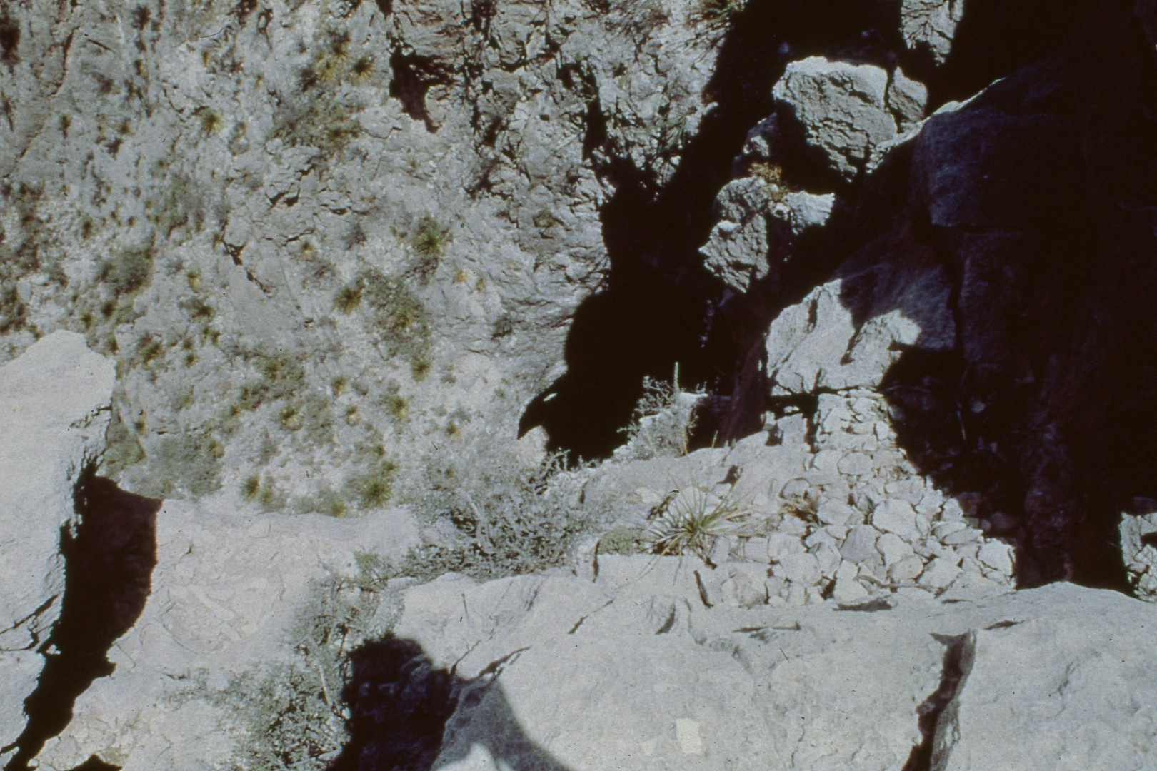
Notes:
Then upon arrival at the cave, the work of cave exploration begins.

Slide 19
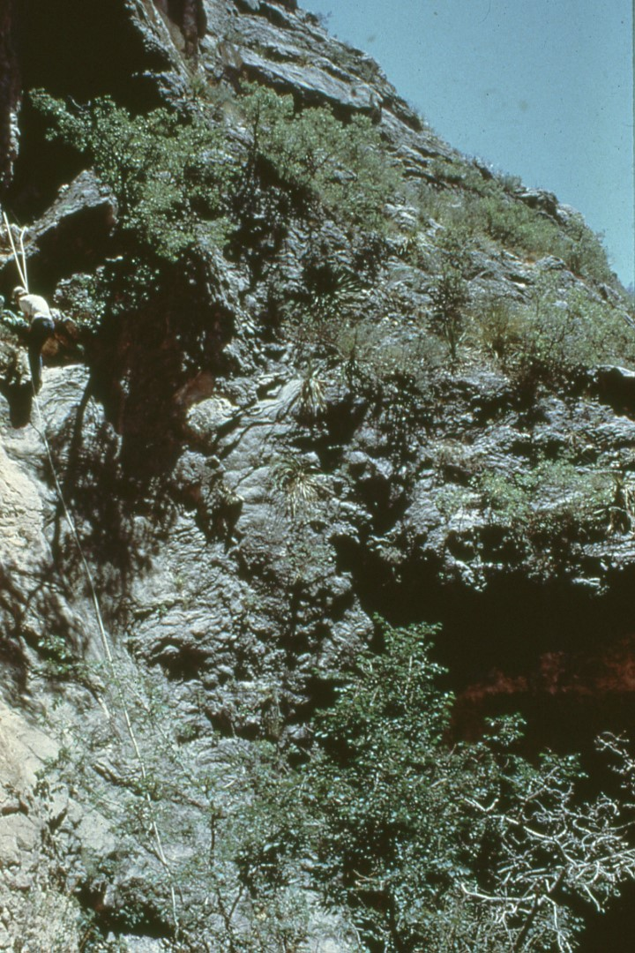
Notes:
This particular cave requires the use of rope techniques to reach the ledge above the mouth of the cave which then becomes the rerigging point for the drop onto the actual cave floor.

Slide 20
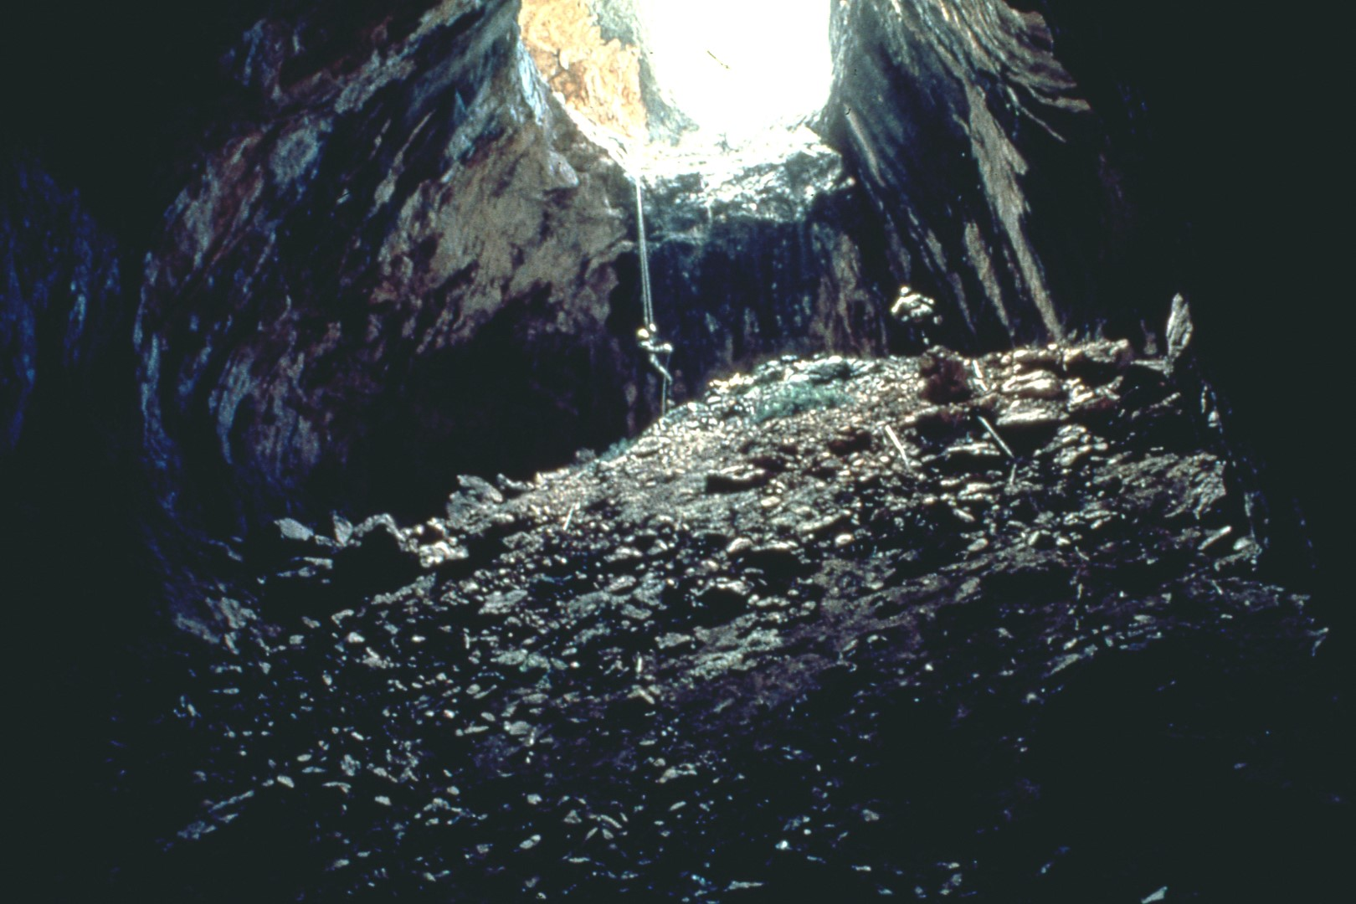
Notes:
While not all Guadalupe caves require rope and climbing techniques, approximately 50% do.

Slide 21
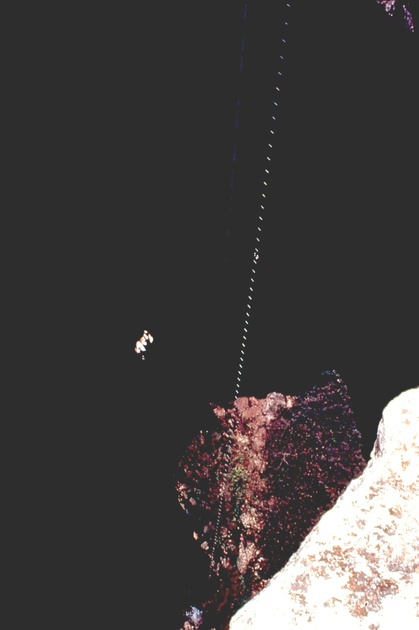
Notes:
Many drops are in excess of 100 feet with the longest drop being 525 feet.

Slide 22
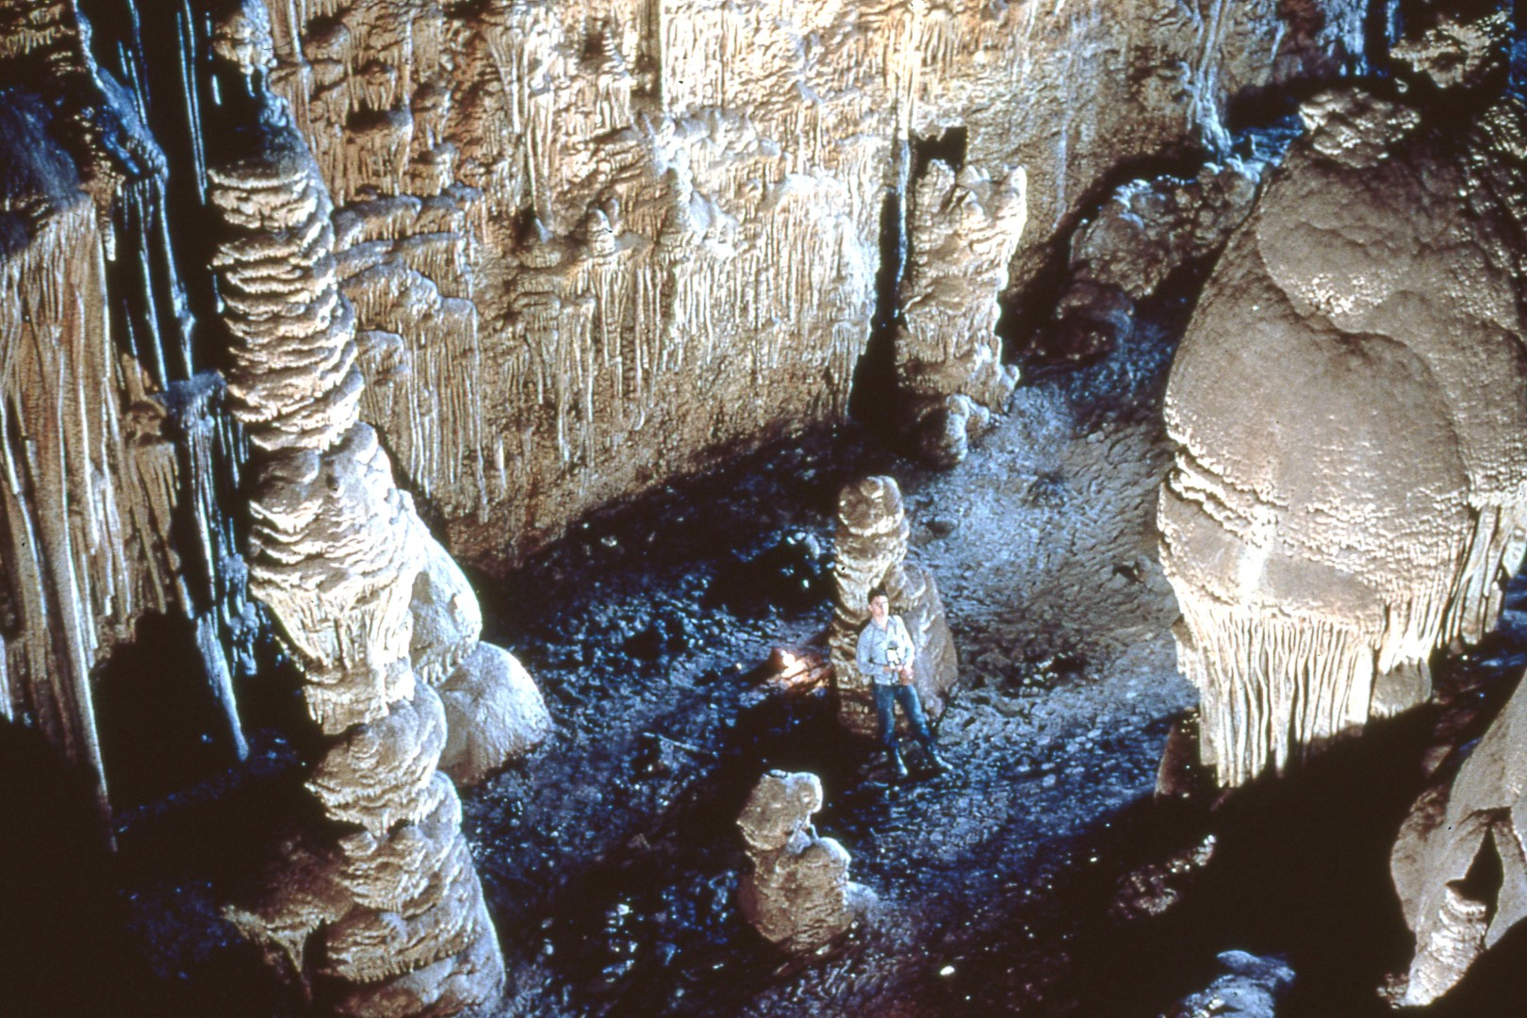
Notes:
Guadalupe caves are considered to be among the most unique and scenic in the world. These extremely large formations are located in the entrance or twilight area of the cave and may be viewed without the assistance of artificial light.

Slide 23
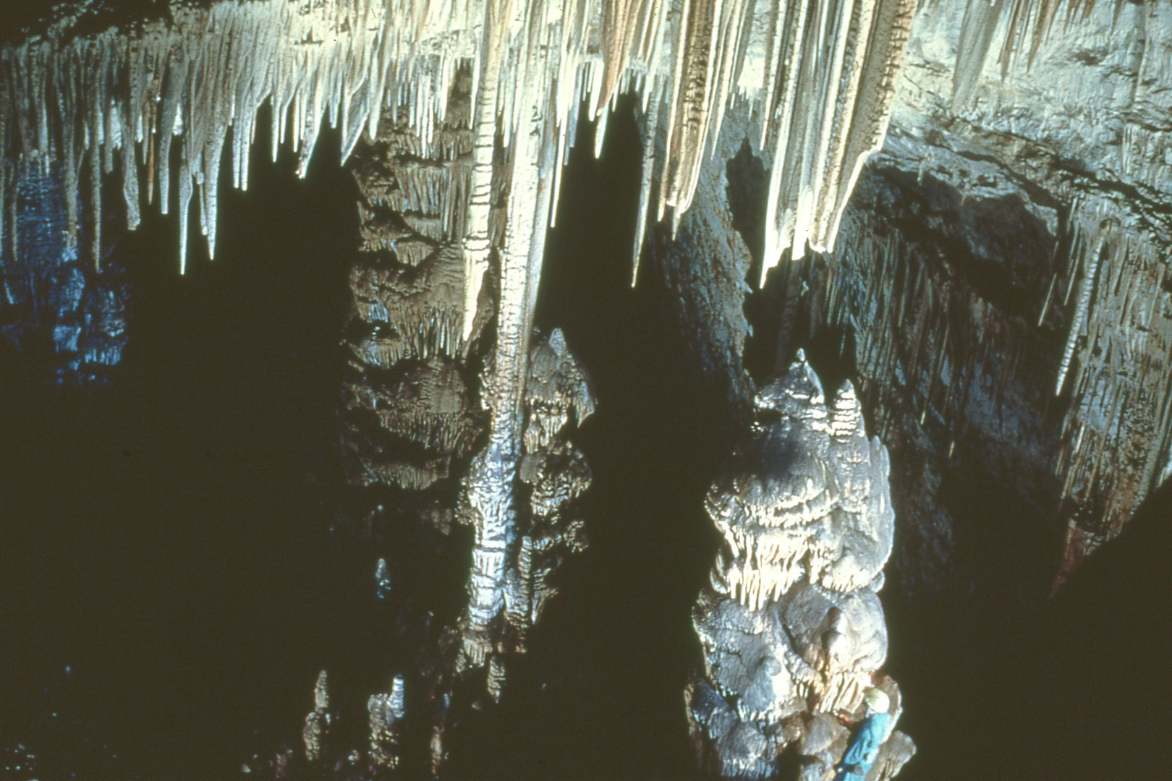
Notes:
Formations of this size are not uncommon, and cavers come throughout the world to view Guadalupe caves which are well known for their extremely large well-decorated galleries.

Slide 24
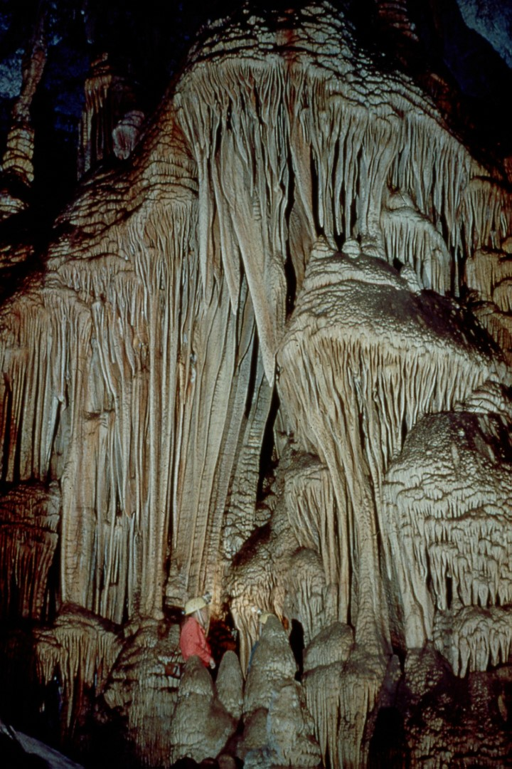
Notes:
These draperies are also located in the twilight area of the cave and even though this picture was taken with the use of a strobe light they may be viewed with natural light.

Slide 25
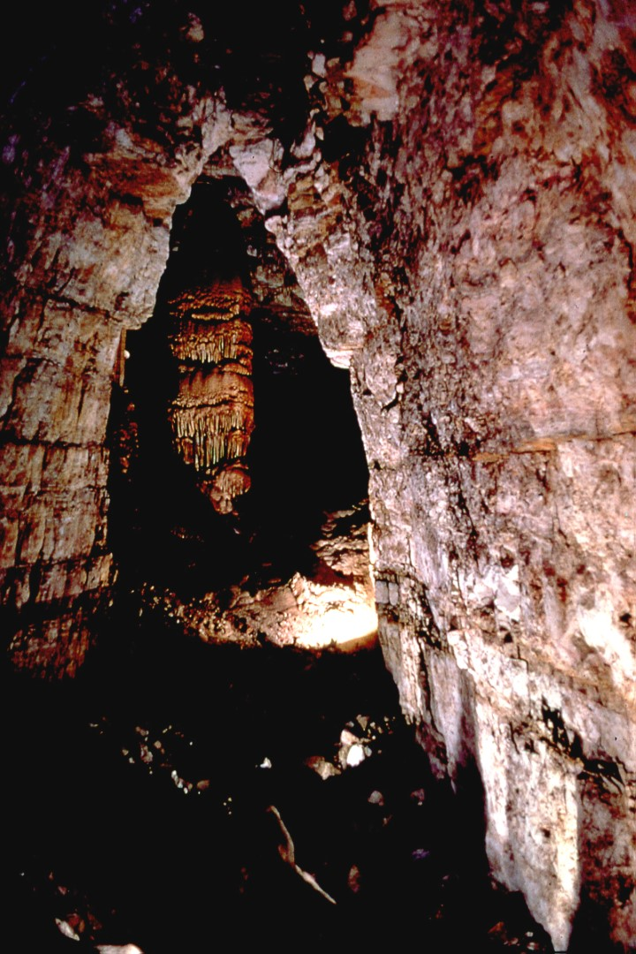
Notes:
The size of this large formation known as Goliath may be appreciated by locating the silhouette person in the bright light in the lower center portion of the photograph. This photograph is a time exposure using only natural light filtering in from the main entrance to the cave.

Slide 26
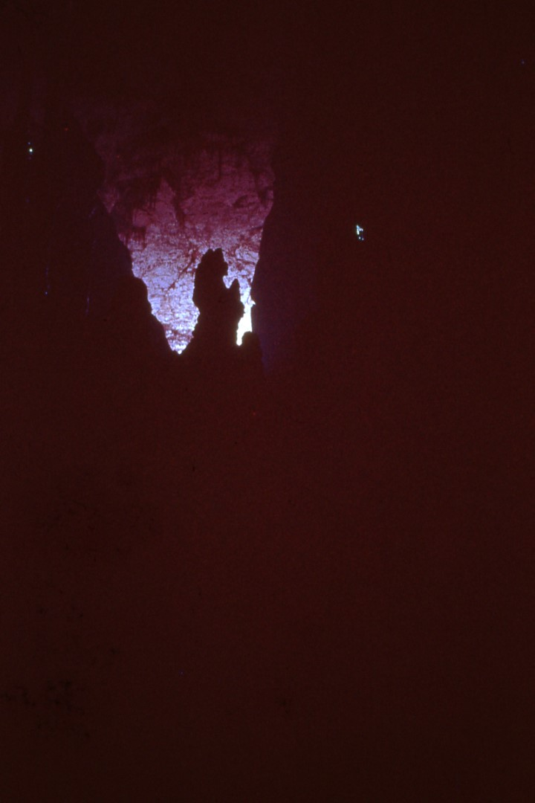
Notes:
This formation is named the Praying Lady because of its silhouette image.

Slide 27
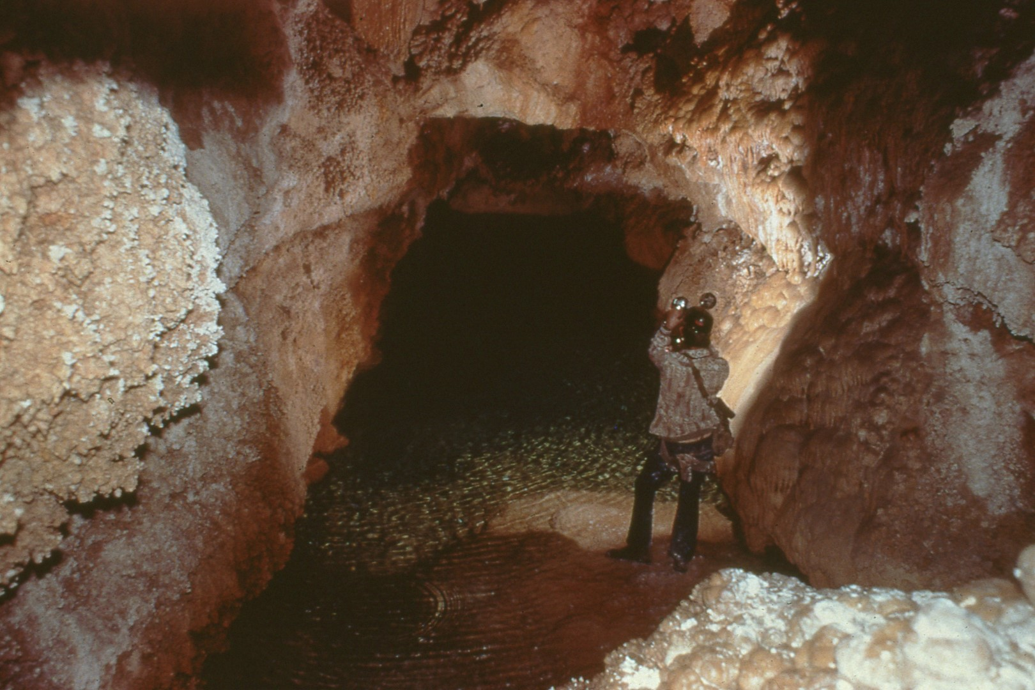
Notes:
Many Guadalupe caves are considered dormant but there still remains many areas with large lakes or pools.

Slide 28
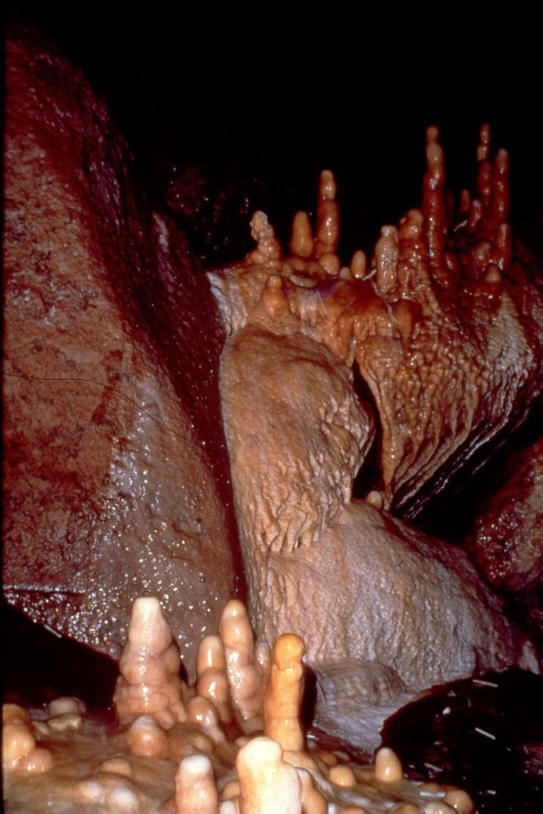
Notes:
and large galleries which are almost totally active.

Slide 29
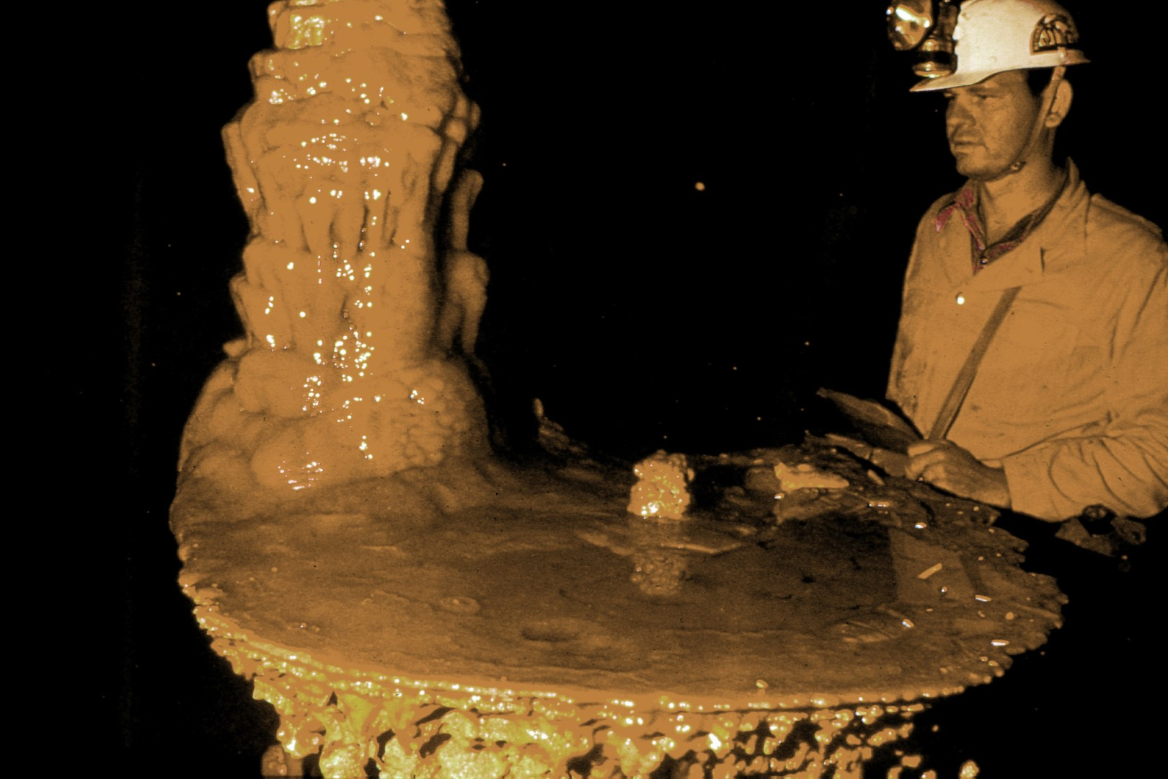
Notes:
These caves are a non-renewable resource in that once that formations are damaged, they will almost never regenerate.

Slide 30
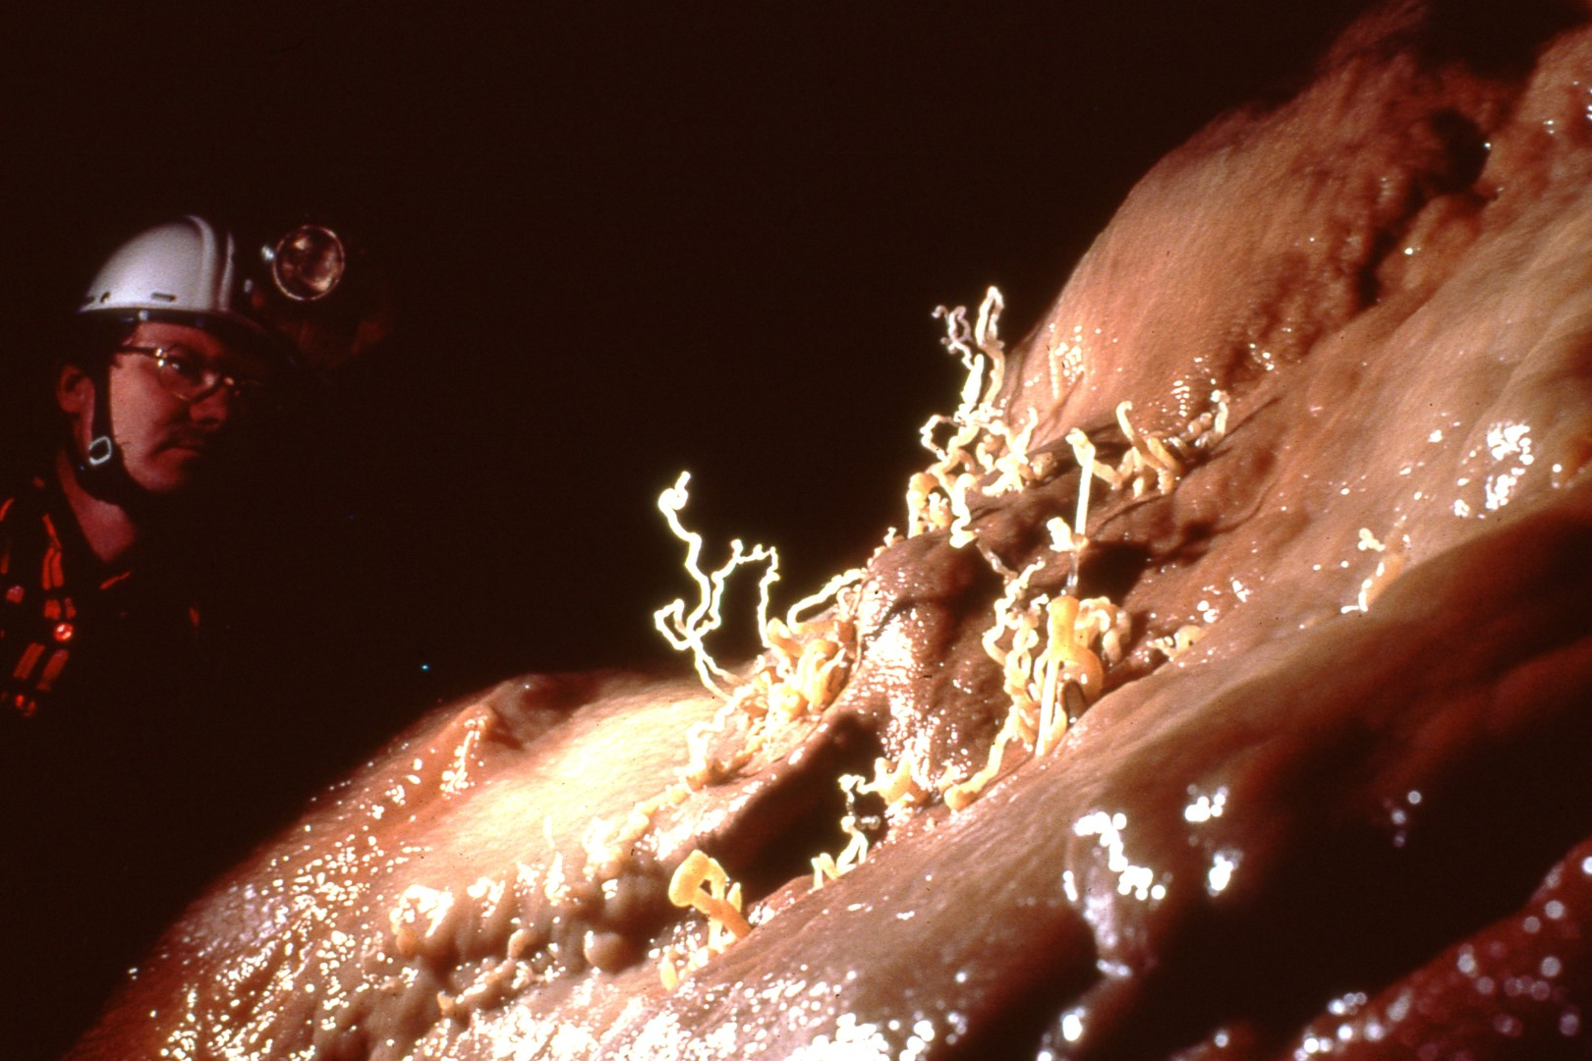
Notes:
Formations such as these which are called helictites, have been broken in the past by the slightest touch or movement.

Slide 31
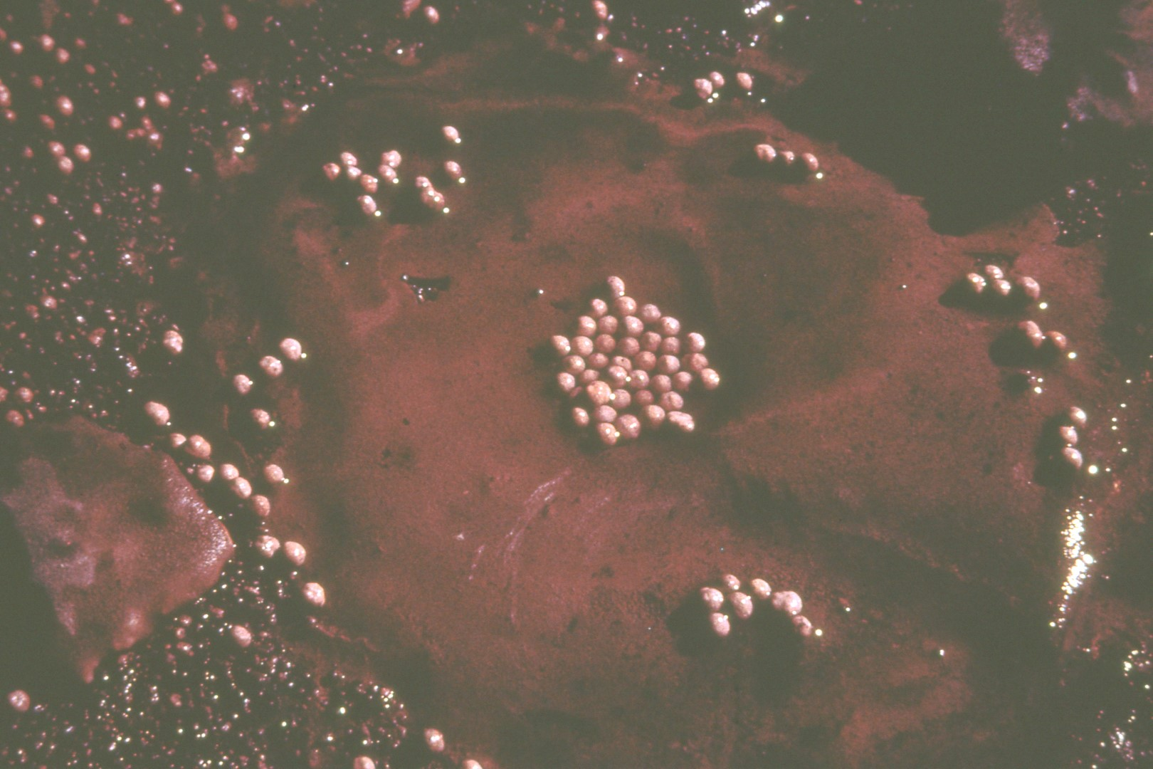
Notes:
Spherical formations such as these which are called cave pearls are always located on the cave floor. These formations are found in only a few caves making them quite rare. Many novice or careless cavers travel through a cave without realizing that rare and delicate formations are being destroyed under their feet.

Slide 32
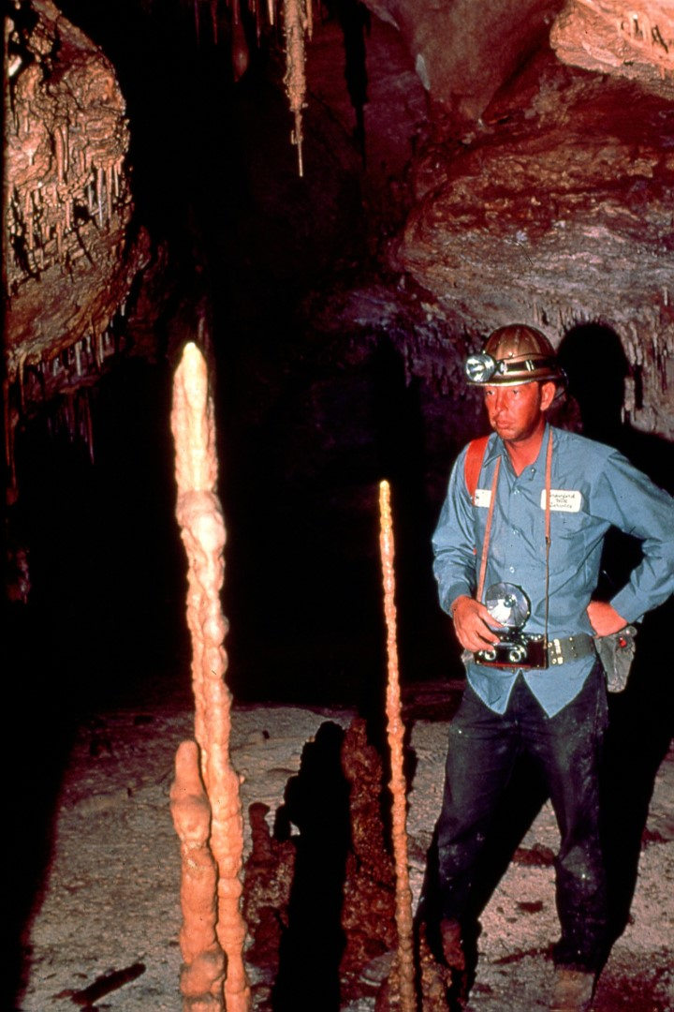
Notes:
There are many stalagmite or stalactite formations that because of their sire, density, and placement in the caves are extremely sensitive to the touch, as are these totem poles. Many have been broken by someone lightly brushing against them.

Slide 33
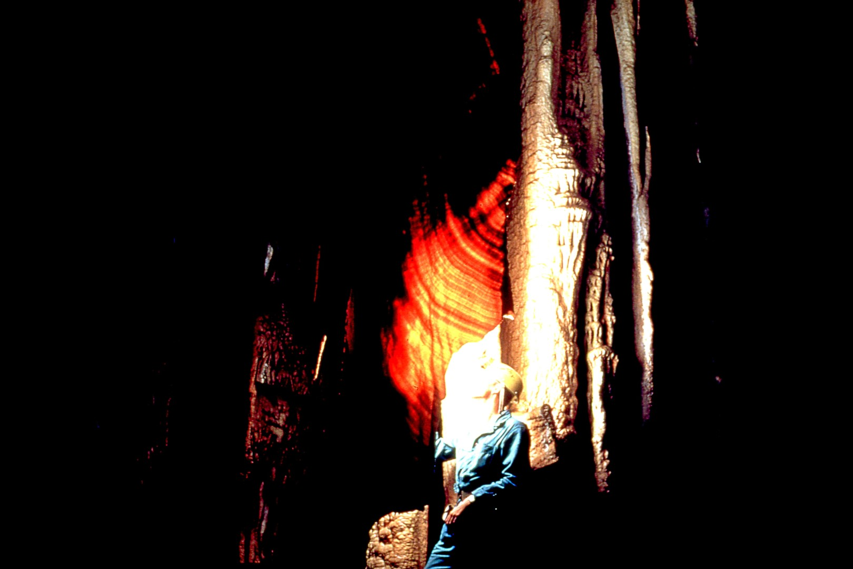
Notes:
Curtains of this type are often very thin and also easily broken. The light and dark bands found in these curtains may be compared to the growth rings that are found in trees except that these bands often represent several hundred years of growth whereas in a tree each ring represents a season.

Slide 34
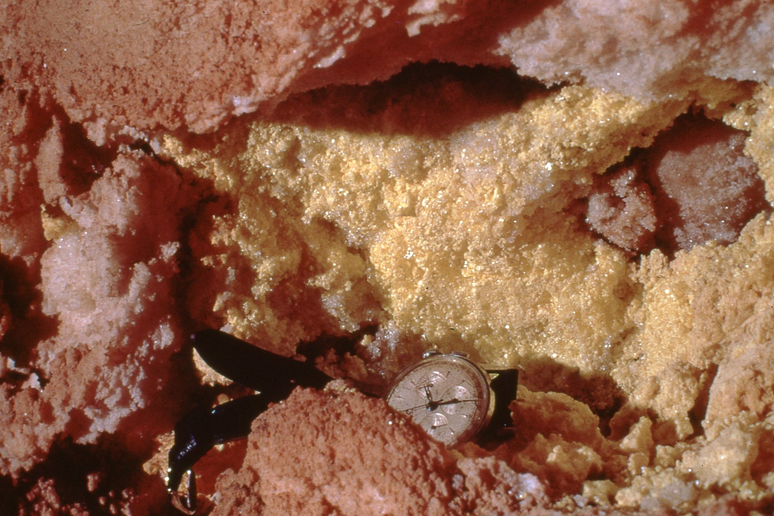
Notes:
A few Guadalupe caves contain deposits of pure sulfur such as this small pocket of sulfur crystals.

Slide 35
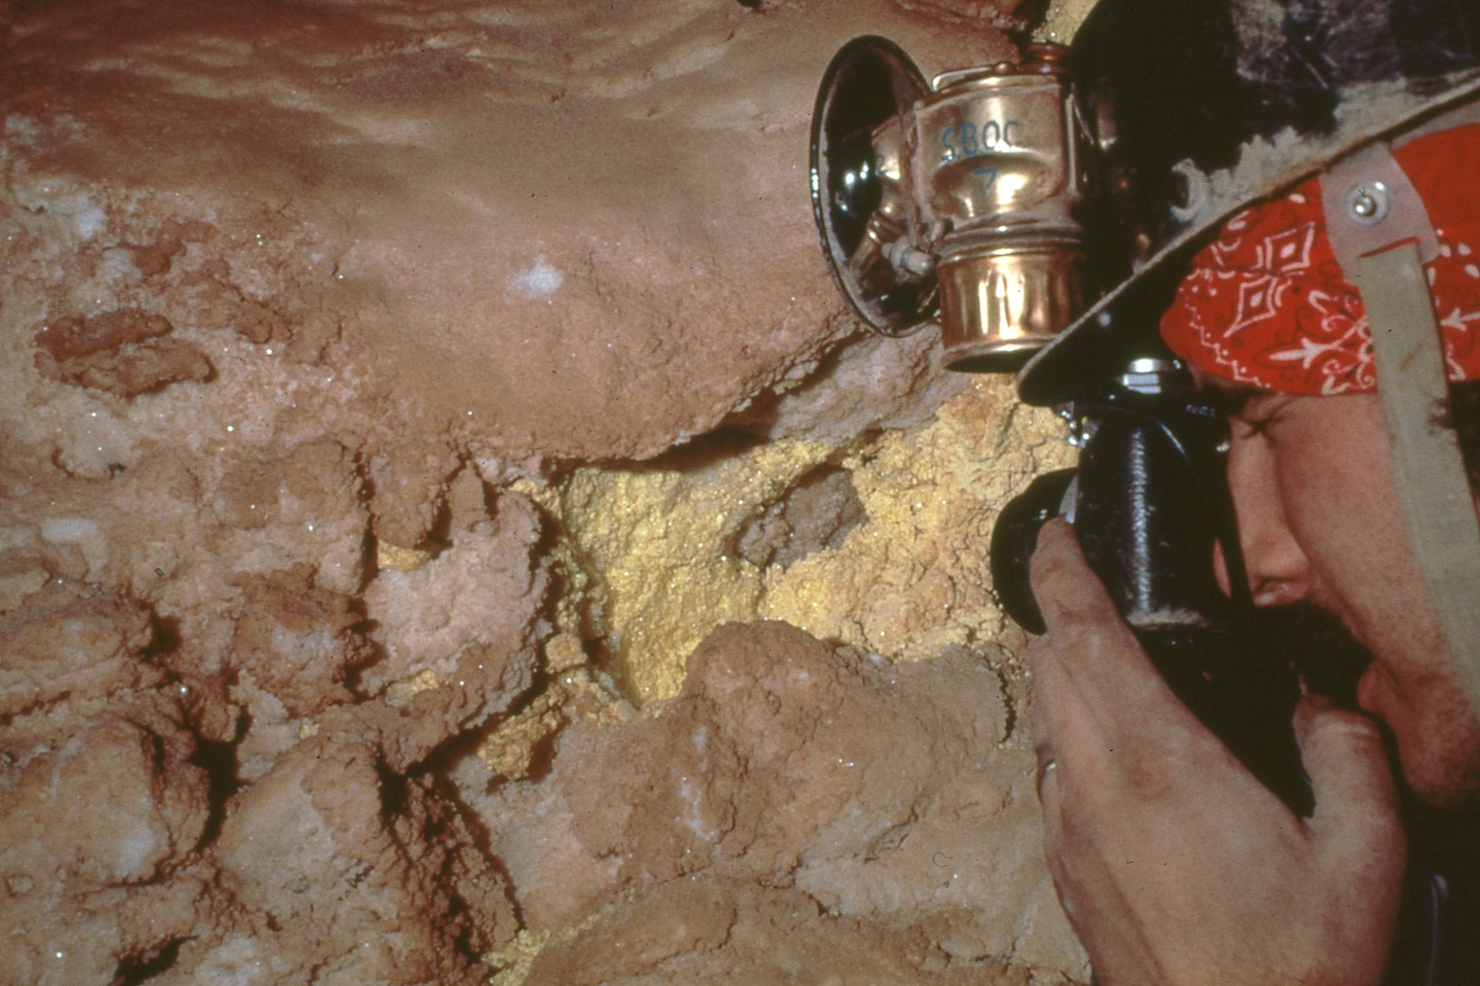
Notes:
This deposit was discovered and studied by cavers and geologists in 1965. For the last 15 years caves specialists have queried cavers from throughout the world about the occurrence of similar pure sulfur deposits in any other cave. To this date there have been no reports of any such deposits documented or even rumored making these deposits extremely valuable for study. The abundance of almost pure sulfur in this passage is thought to be responsible for the mutation of gypsum into many crystalline forms.

Slide 36
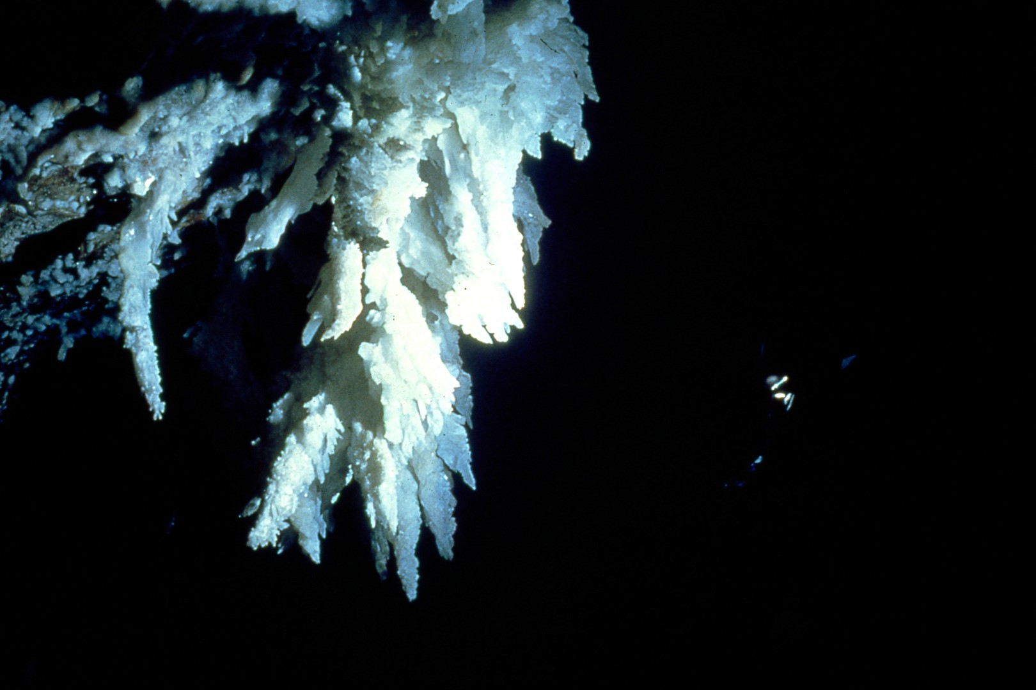
Notes:
This extremely large gypsum flower called the Chandelier …

Slide 37
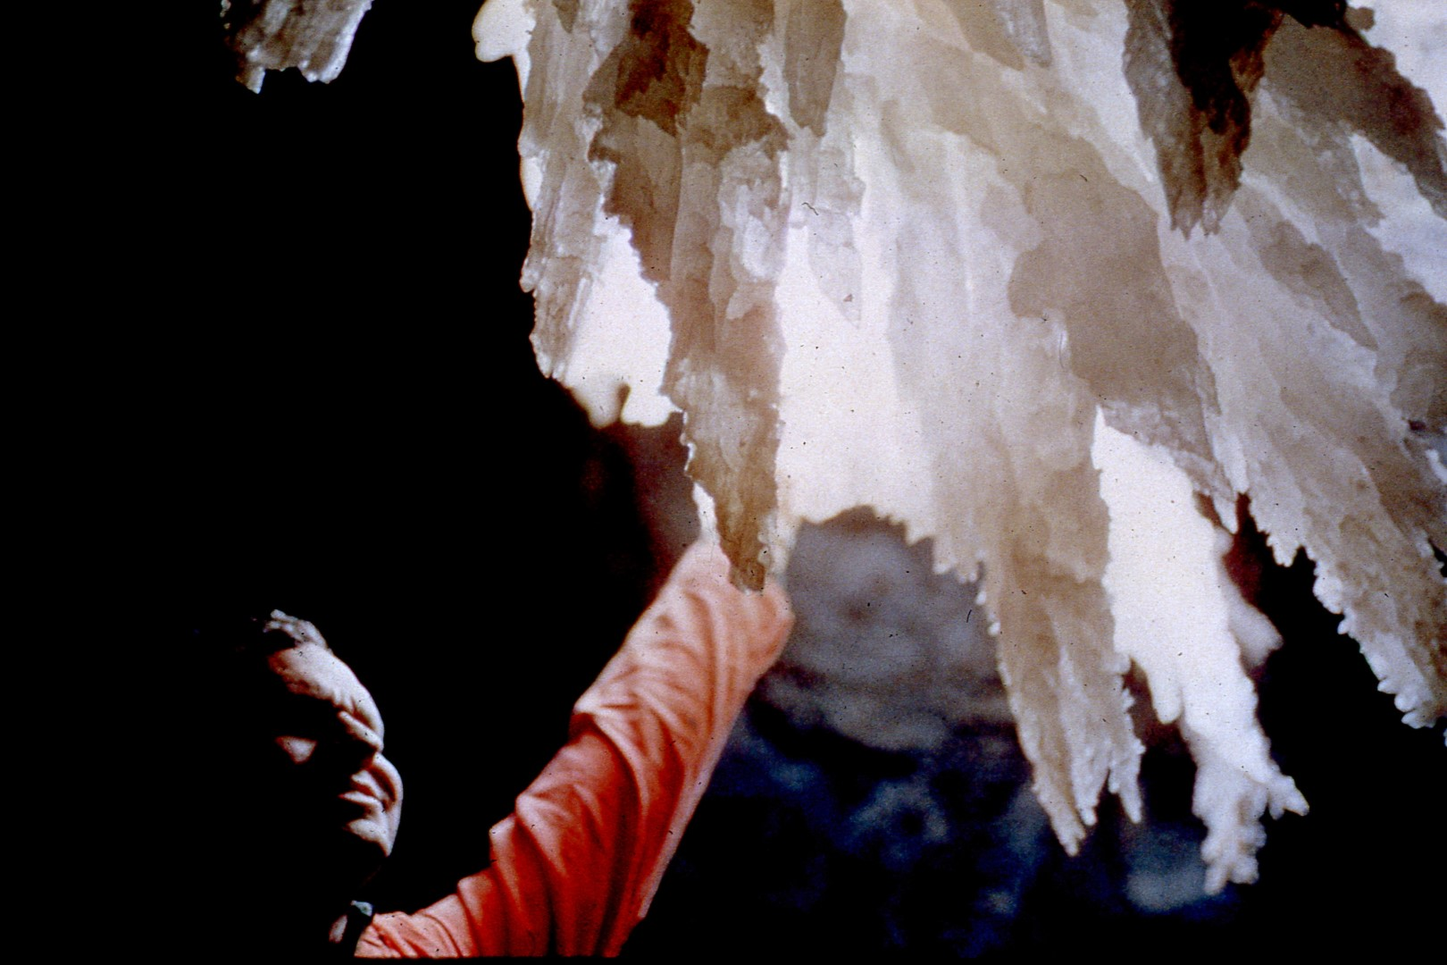
Notes:
is the largest known to exist in the world and is located in a joint passage of a Guadalupe cave.

Slide 38
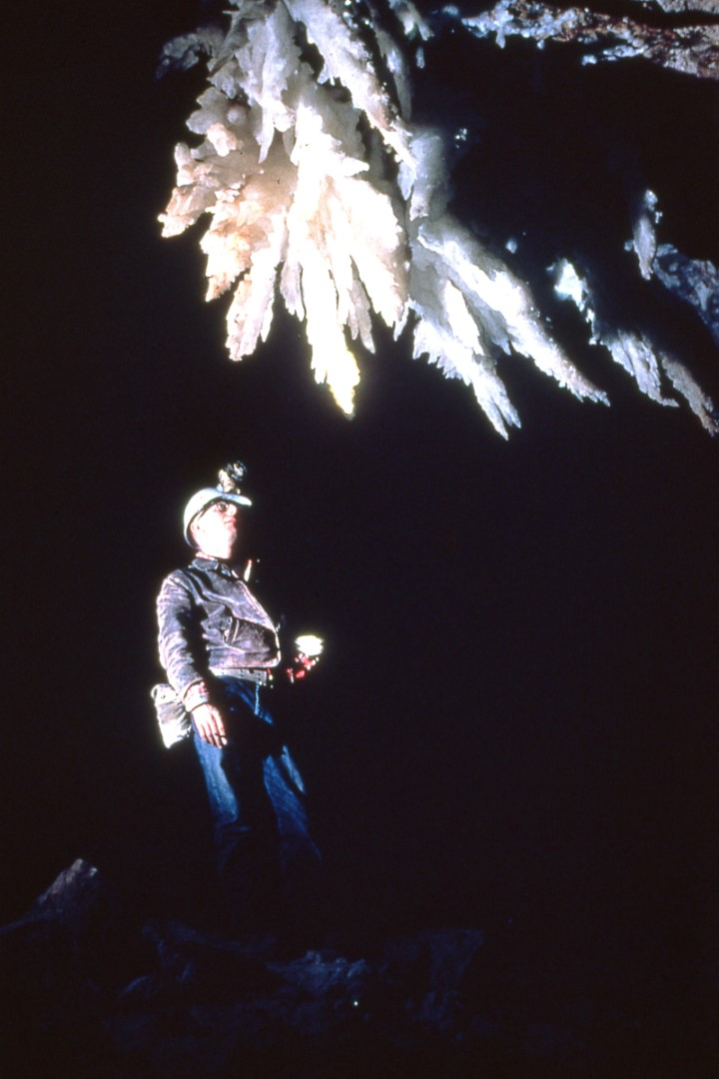
Notes:
As far as is now known the five largest gypsum flowers in the world exist in this one passage.

Slide 39
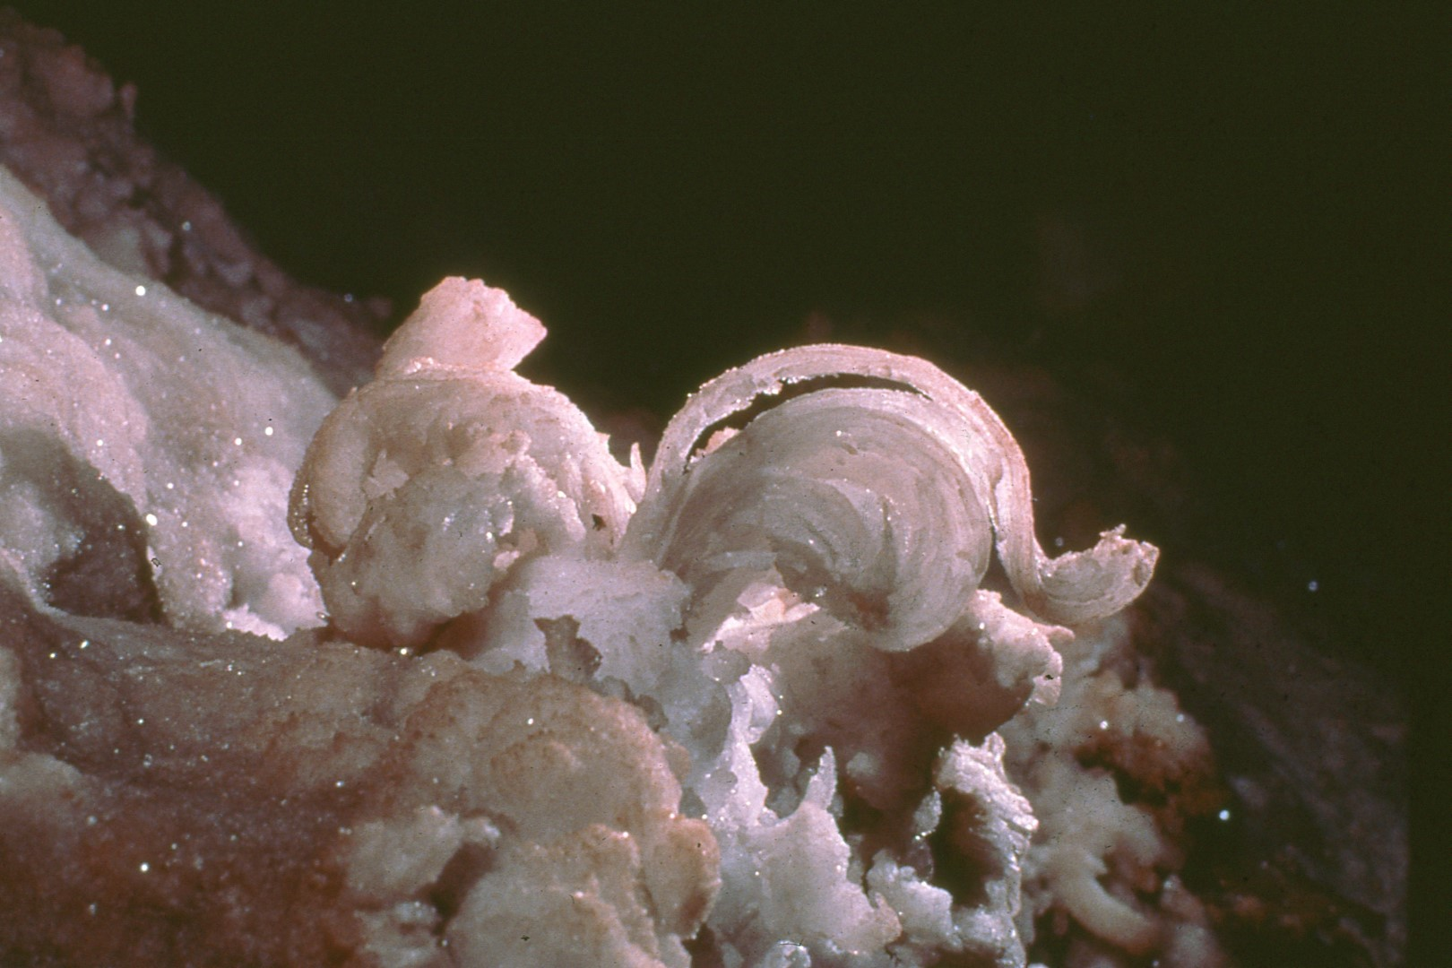
Notes:
Whatever crystalline form gypsum takes; it is always very fragile …

Slide 40
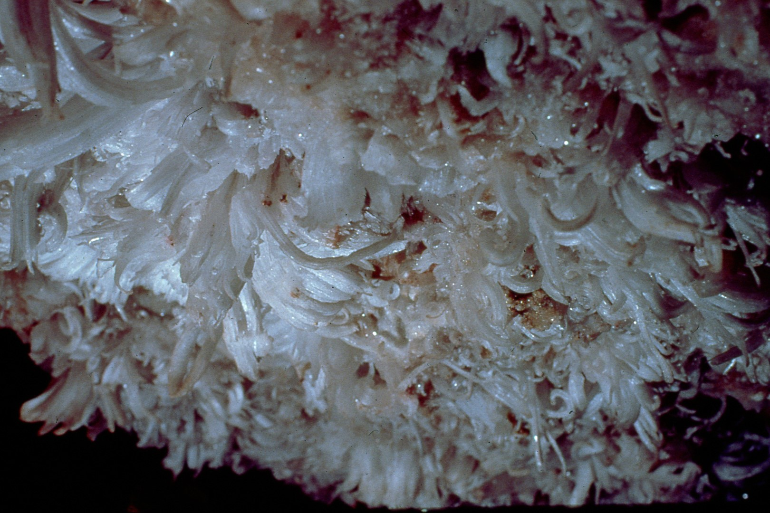
Notes:
even in large displays such as this.

Slide 41
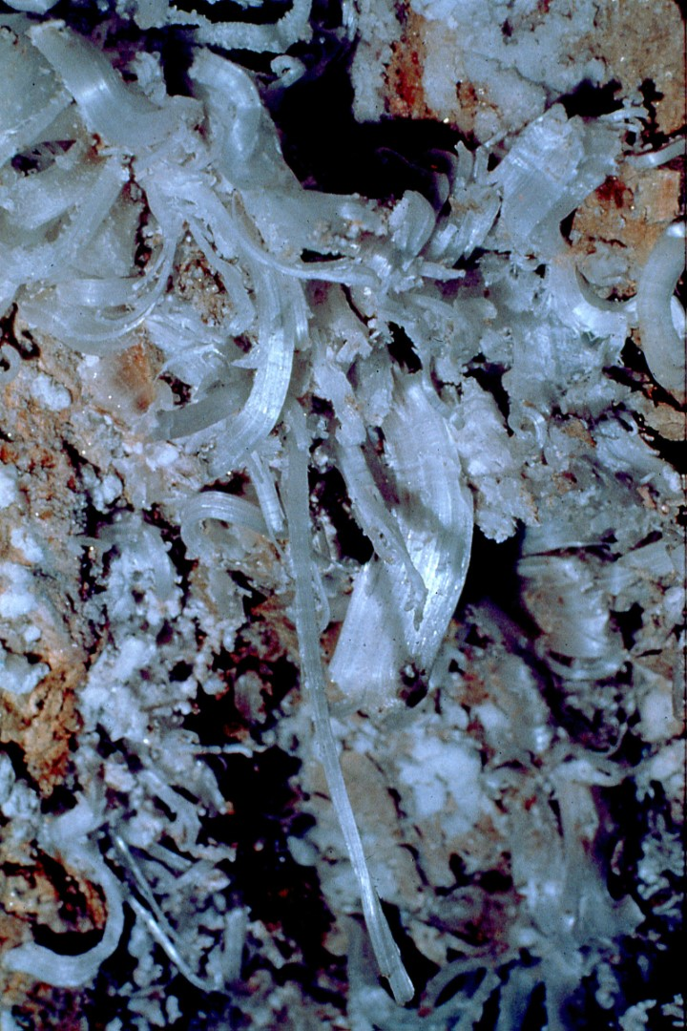
Notes:
Because of vandalism this formation has been reduced to less than one half of its original size.

Slide 42
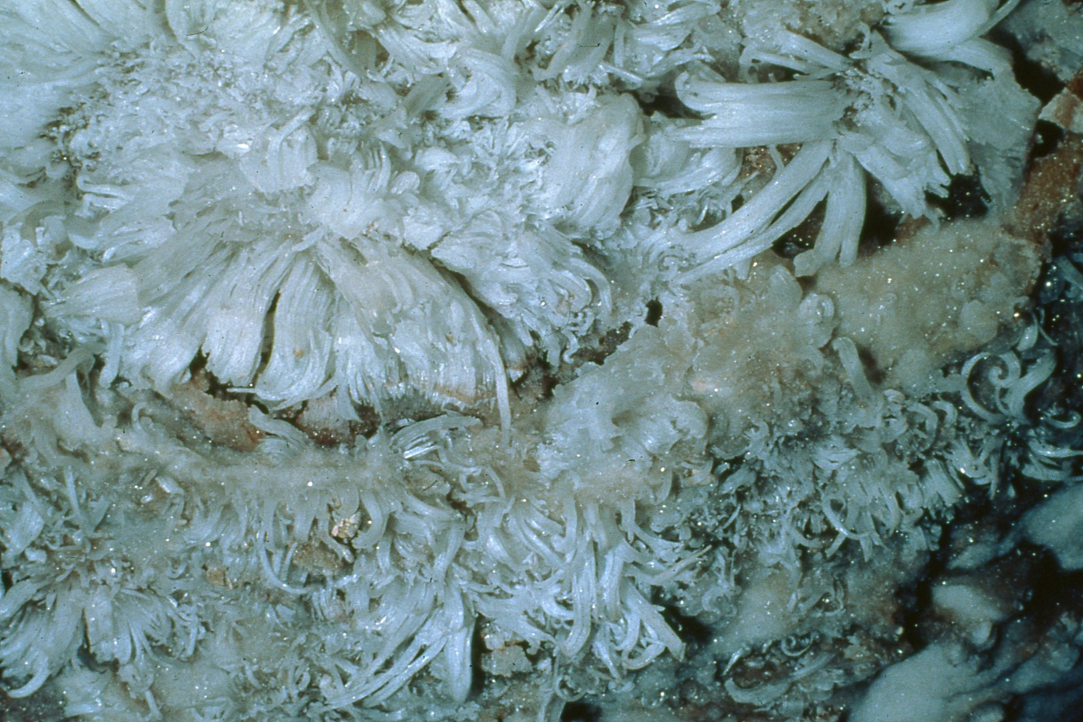
Notes:
Even though damage in this area has been extreme there still remains some magnificent crystalline formations such as this gypsum flower located high on the passage wall. This beautifully decorated ceiling is in a very small room of a well-traveled cave. The opening to this room was sealed by cavers in 1960 by rolling rocks over the entrance. Because vandalism was so extensive in the rest of the cave conservation-minded cavers thought this room would also be destroyed before cave gates could be installed and properly maintained. The room was reopened after the cave was gated and included in the permit system.

Slide 43
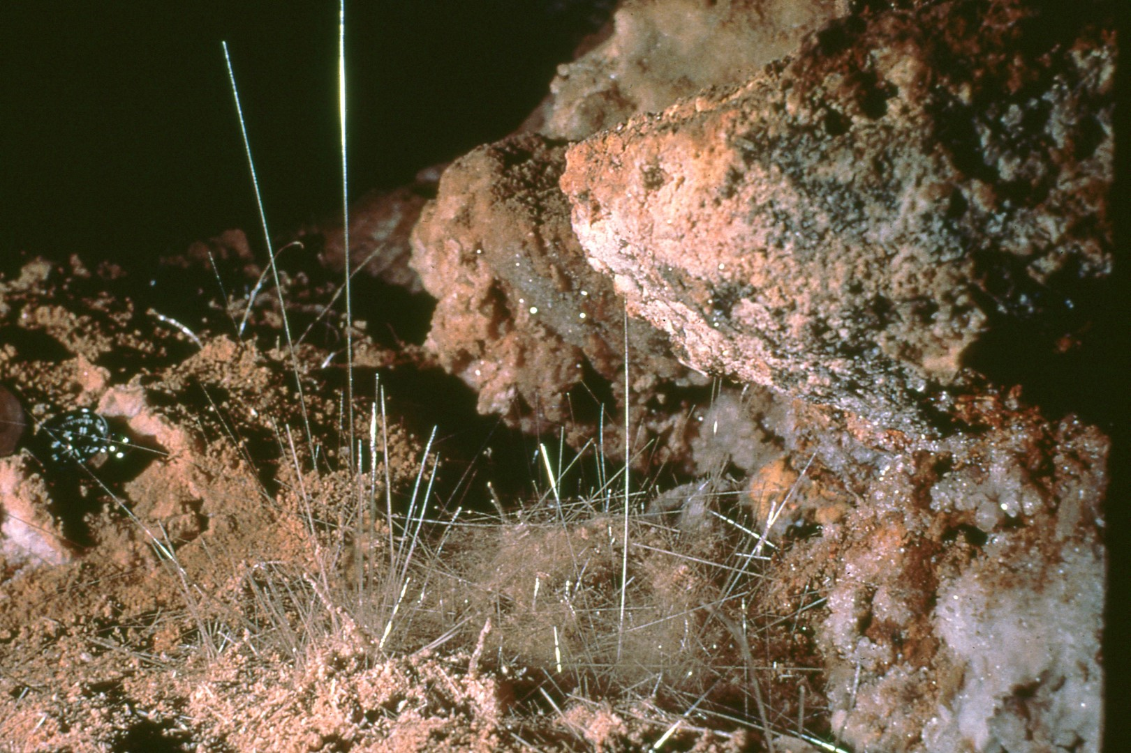
Notes:
Selenite needles are extremely rare and are so delicate that air currents caused by cave explorers walking in the passage can destroy them.

Slide 44
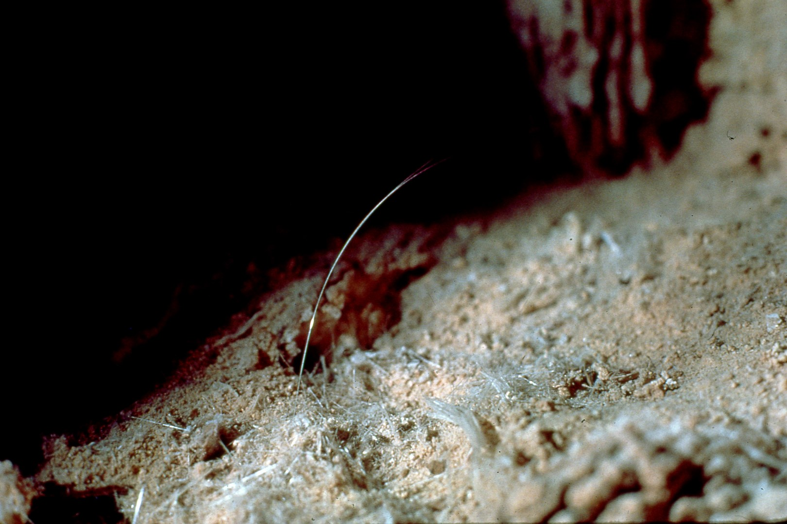
Notes:
The tallest needle in this picture is 19 inches. In the same joint passage, there are many selenite needles in excess of four feet in length.

Slide 45
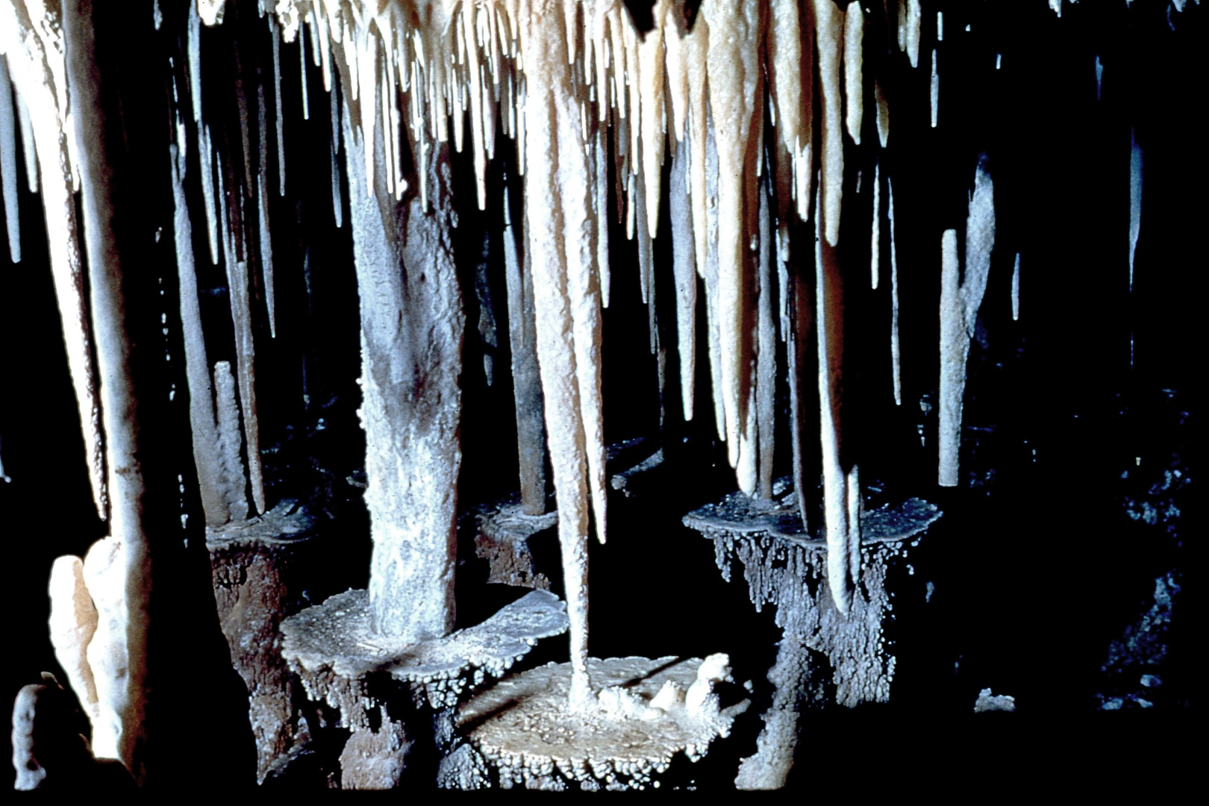
Notes:
This particular room has been called the Candle Table Room due to the lily-pad-like tables created by an ancient lake which has now receded to a lower level.

Slide 46
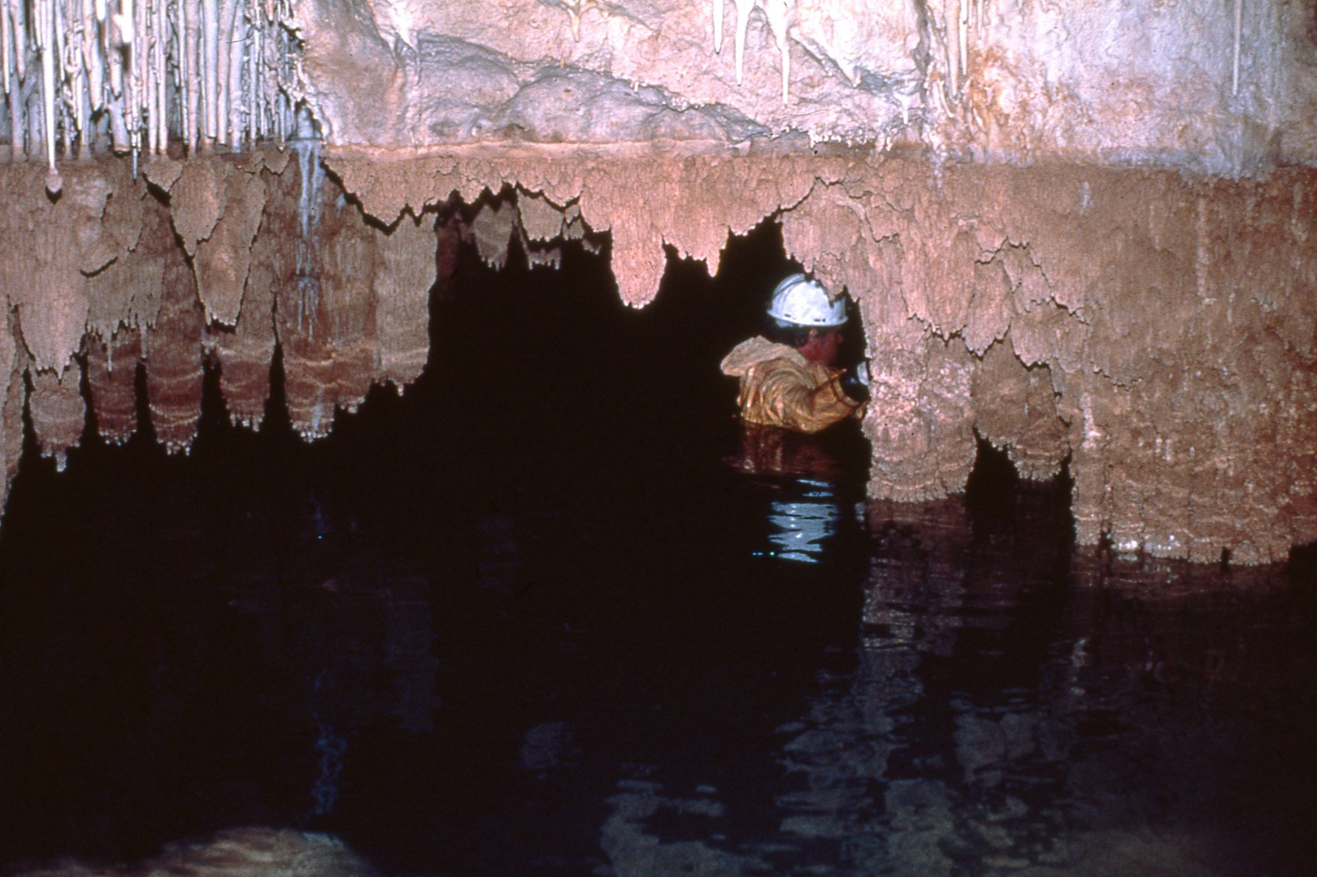
Notes:
The lake still must be traversed to get deeper into the cavern passage. This lake has created a barrier or hazard too great for most cavers to attempt which has resulted in the areas beyond the lake remaining in almost perfect condition.

Slide 47
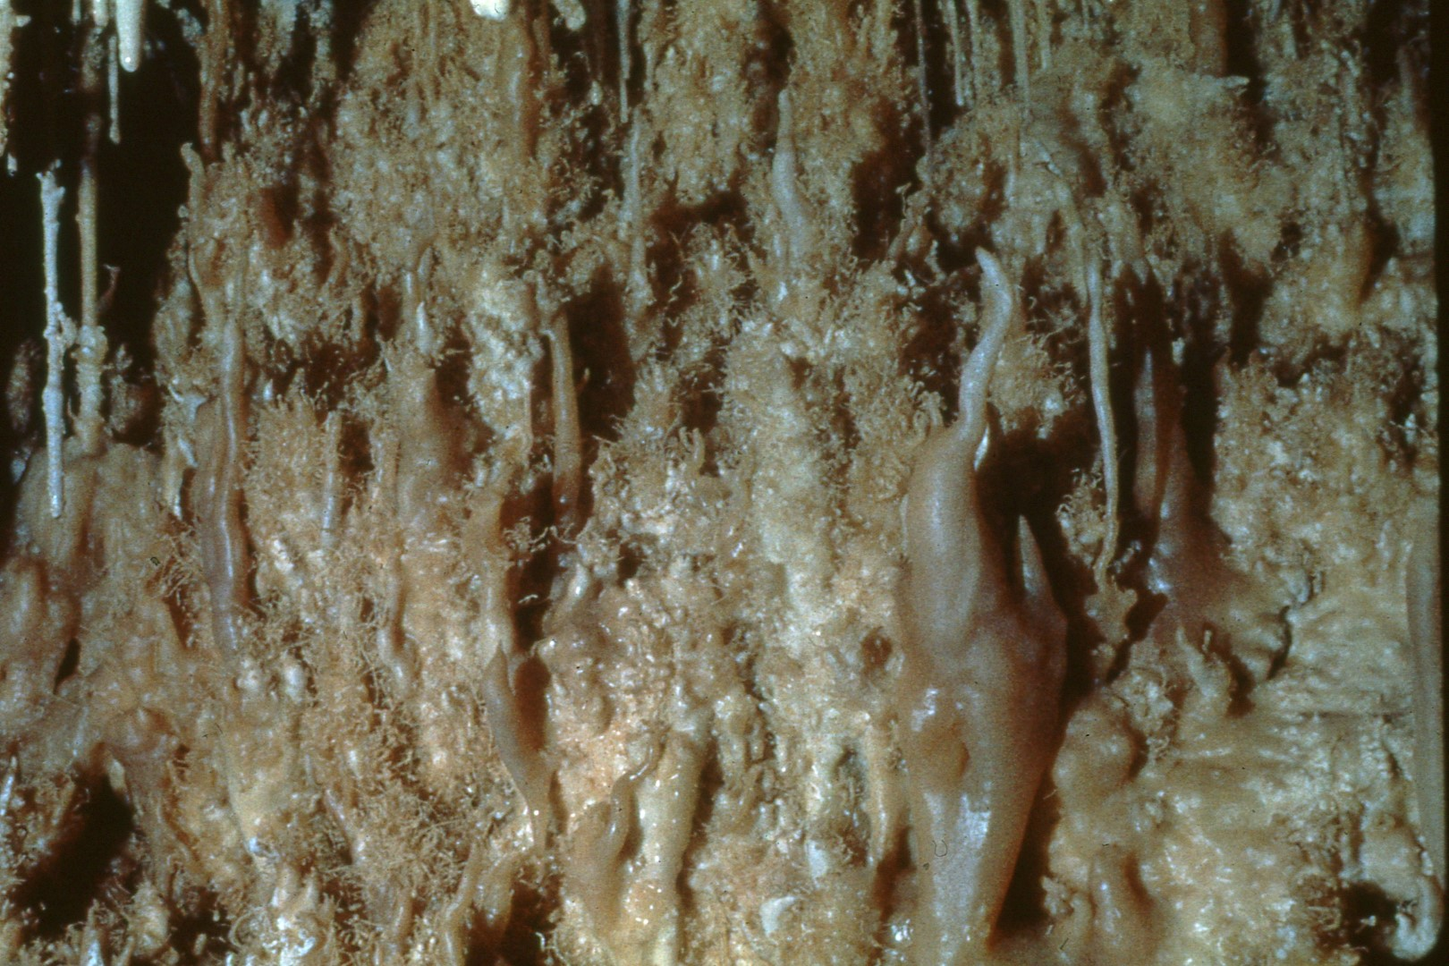
Notes:
The areas seen in these photographs are unique and colorful and extremely fragile, but thanks to the lake were preserved for the hardy conservation-minded caver.

Slide 48
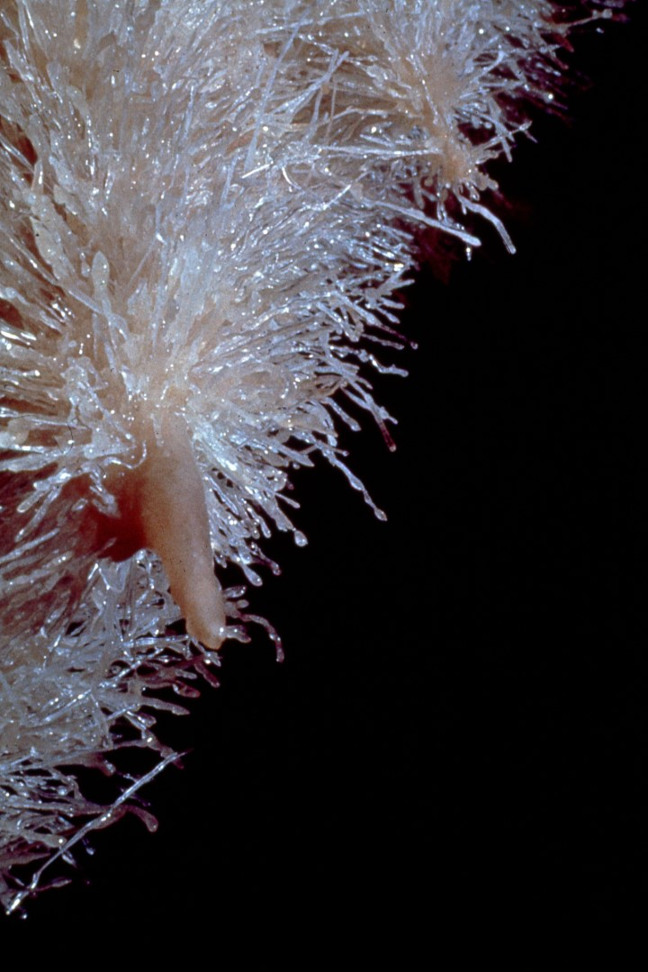
Notes:
These helictites are extremely fragile and many similar ones have been destroyed.

Slide 49
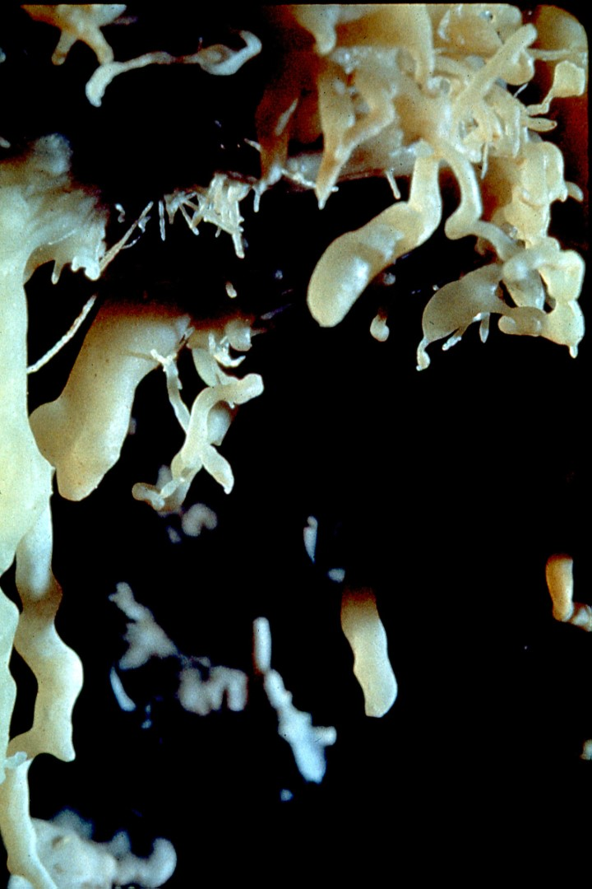
Notes:
The passage is only about four-feet tall and a caver would have to crawl on hands and knees across these beautiful formations in order to continue exploration. There are many other areas of Guadalupe caves that have remained in pristine condition because of natural hazards in the caves.

Slide 50
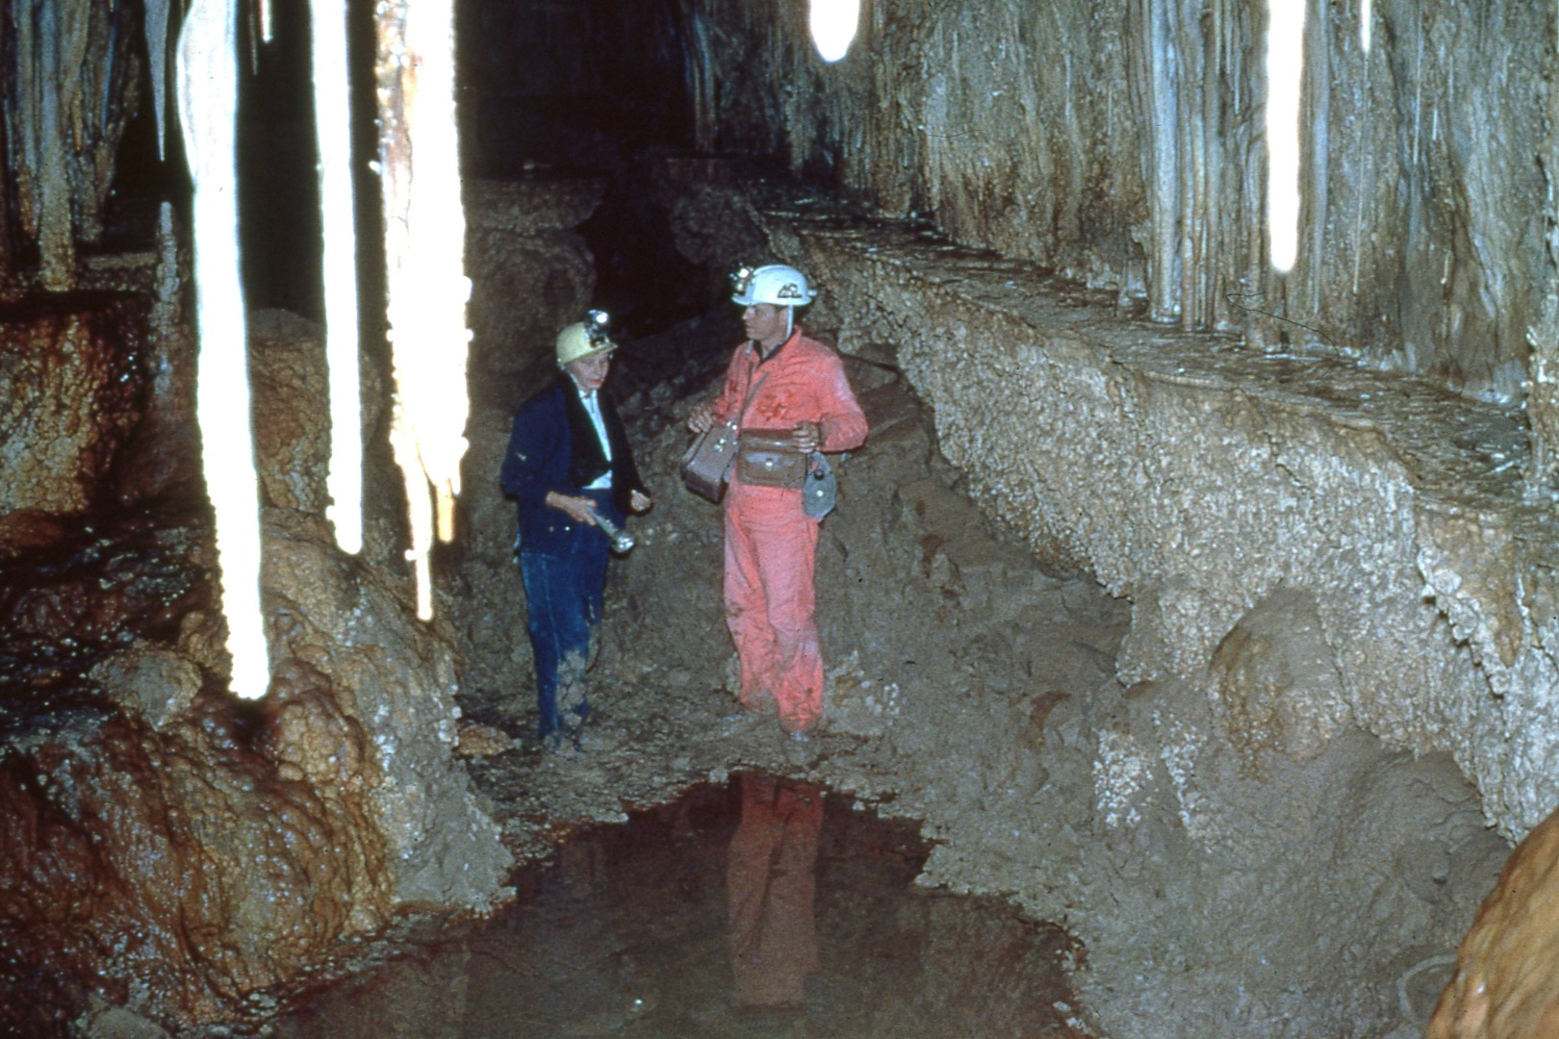
Notes:
For explorers to continue on in this passage would require wading in very deep water and muddy clay.

Slide 51
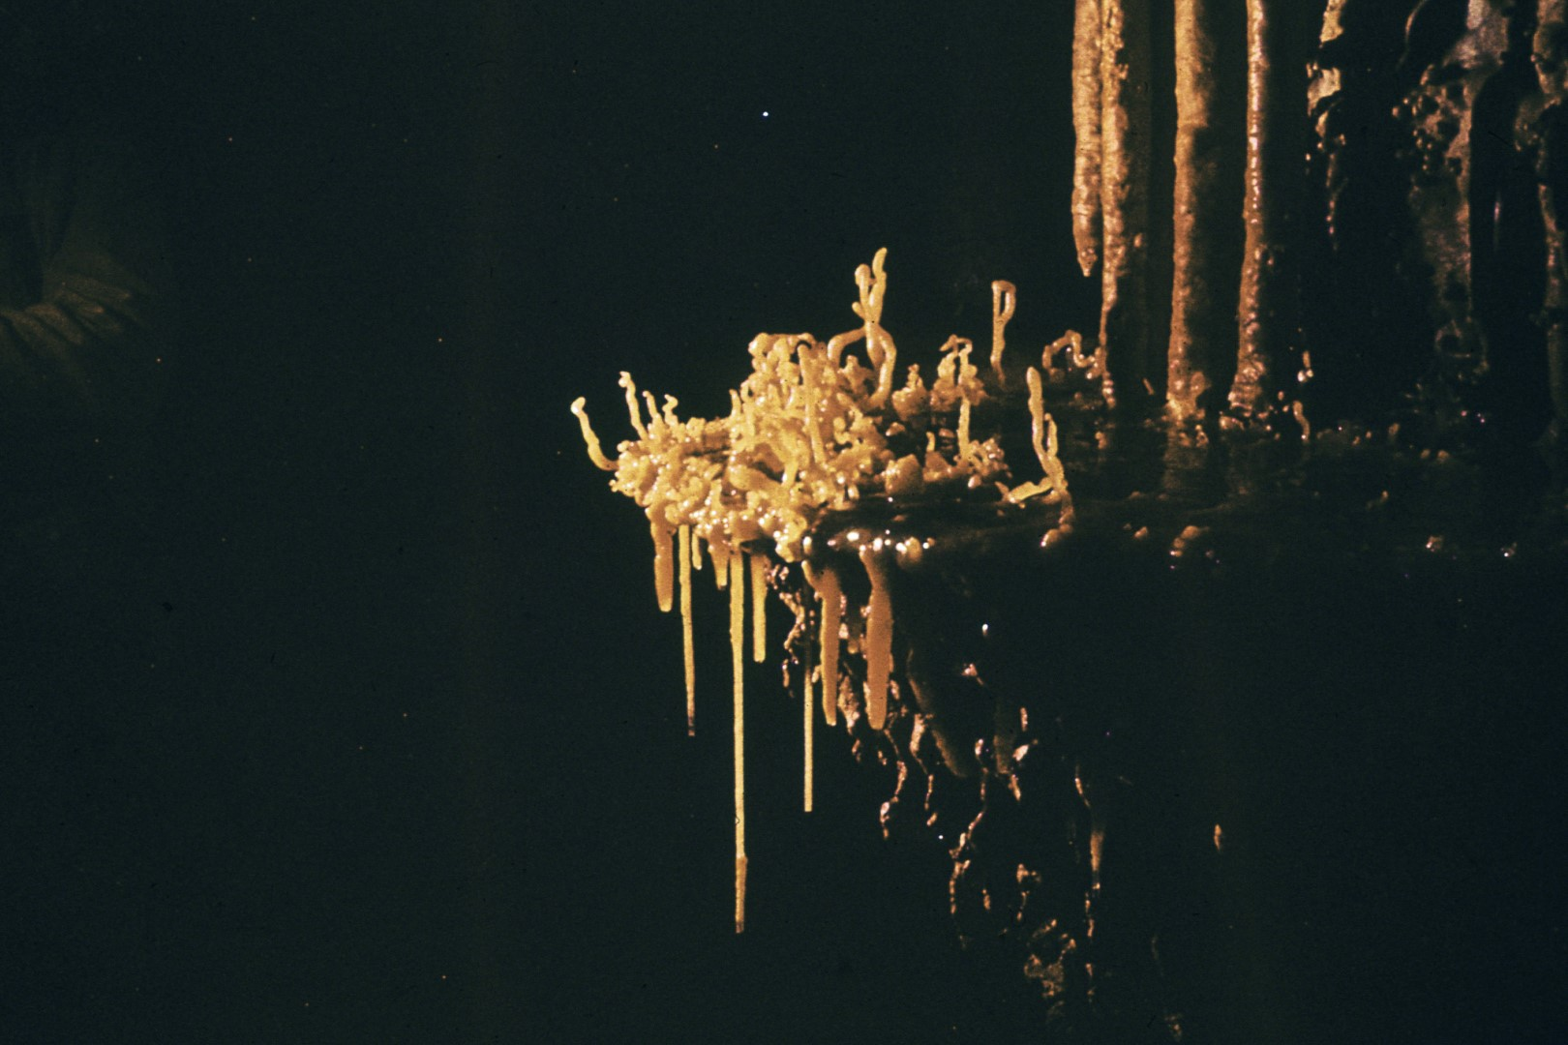
Notes:
However, those who do go beyond this area are well rewarded by some of the most spectacular displays of helictites and lily pads found in any cave.

Slide 52
Notes:
The colors range from bright reds, to oranges, yellows, light blues and colorless formations.

Slide 53
Notes:
Most of the formations in this particular area of the cave are still growing and virtually undamaged.

Slide 54
Notes:
In addition to formations there are other specific aspects--of caves that need to be preserved for future study. These roots extend 200 feet into the cave from cracks in the cavern's ceiling. At the present time the roots have not been identified and have been tom apart by careless cavers which will prevent any future study of their growth. There are other caves containing roots of this type which if they can be preserved and protected should be studied in the future.

Slide 55
Notes:
While it is not common there are many animals which do use caves for shelter, a source off water and in some cases, food.

Slide 56
Notes:
Porcupines and many other mammals frequent the area around cave entrances.

Slide 57
Notes:
The Guadalupe caves are home for various species of bats.

Slide 58
Notes:
Many caves are hibernaculum for the bats in winter months and in some cases, they are bat nurseries. It has been learned that hibernating bats that are awakened do not survive because their heartbeat, respiration, and metabolism increase to normal and they starve to death before they can decrease their body functions to the catatonic or hibernating stage.

Slide 59
Notes:
There is no food during this period resulting in starvation. This type of knowledge must be considered in future cave management decisions regarding time of year, frequency of visitation, and competency of individuals permitted access to the caves.

Slide 60
Notes:
In addition to the many animals and insects that use caves, there are also a great many fossil remains such as this one.

Slide 61
Notes:
Caves are almost the perfect storehouse for fossilized remains due to constant temperature, humidity, and other factors that add to long term preservation.

Slide 62
Notes:
This skeleton was thought to be a panther but has since been identified as an extinct cave bear.

Slide 63
Notes:
There have been many skeleton remains found in Guadalupe caves of extinct animals such as dire wolves, bush ox, musk ox, and a three-toed horse. The human bones found in one cave have been carbon-dated and determined to be about 10,000 years old, or Pleistocene in age. This particular discovery is of paleontological importance as no other remains of pre-historic man of this era have been found in southeastern New Mexico.

Slide 64
Notes:
The extreme damage that has been done to some of the Guadalupe caves may be best depicted by a series of "before" and "after" photographs although when destruction is close to 100% it is often difficult to tell that the photographs were taken in the same place. In this photograph taken in April of 1961, a beautiful array of selenite needles is displayed. The area behind the needles which is in the shadow will be visible in the next photograph which was taken only a few months later and shows the magnitude of the destruction.

Slide 65
Notes:
Virtually all of the selenite needles have been destroyed. The real tragedy of this particular type of vandalism is that these needles do not survive when taken from the cave. They lose their moisture content that is maintained in the almost 100% humidity of the cave, crumble and turn to dust so the vandal has not gained anything by taking the needles out except their total destruction.

Slide 66
Notes:
In this photograph which also shows selenite needles, the main attraction is the gypsum rope hanging just right of center. The mushroom-shaped stain in the upper left-hand corner can be seen in both photographs,

Slide 67
Notes:
however in the second photograph the gypsum rope is gone.

Slide 68
Notes:
This particular display of epsomite was one of the most magnificent ever observed by cavers.

Slide 69
Notes:
In this incidence it is difficult to tell that the "before" and "after" photographs were taken in the same place because of the degree of destruction. There are a few small pieces of formation that remain in the second photograph, but they are so few that only the profile of the cave wall is recognizable. These preceding photographs show the magnitude of the vandalism that has occurred in many caves in recent years.

Slide 70
Notes:
In this cave passage, which is extremely large and extensive for Guadalupe caves, it is estimated that the destruction is as high as 95%.

Slide 71
Notes:
This room is called the Candle Table Room because of the formation in the foreground. The larger tables that grow both to the ceiling and to the floor have not been severely damaged, but all the formations that were attached to only the ceiling or the floor and lack total column support have been destroyed.

Slide 72
Notes:
As can be seen in the second photograph the table has been removed by vandals. However, the table was so heavy that they were only able to carry it a few hundred yards before abandoning the effort.

Slide 73
Notes:
It was replaced a year or so later by using a battery-operated drill. A hole was drilled in the formation and the floor.

Slide 74
Notes:
A stainless-steel peg was installed and with the use of epoxy and rigging the table was placed in position.

Slide 75
Notes:
However, the candle-like top is no longer a part of the formation.

Slide 76
Notes:
In this same room some cleaning and restoration work was done. The dusty dirty appearance of these tables is due to people stepping on, sitting on, and otherwise touching them. If you look carefully you can see two places where people have extinguished their cigarettes on the formation. Explorers who were in this part of the cave soon after it was first discovered, having seen so much destruction over the years began to wonder if certain formations were as spectacular as they remembered them to be.

Slide 77
Notes:
So in 1974 Forest Service cave specialists used a regular household sprayer and soft brush to clean the formations.

Slide 78
Notes:
The second photograph shows the success of the project and the value of such restoration work in the future.

Slide 79
Notes:
Only the two areas where the cigarettes were extinguished on the formation did not come clean.

Slide 80
Notes:
Formations that have graffiti written on them often can be cleaned with a great deal of success because the graffiti is very superficial. By spraying the formation with a fine mist and allowing it to soak up the exterior coating of dirt and dust the graffiti may then be removed with a soft brush and high-pressure spray.

Slide 81
Notes:
As can be seen in this photograph it not only cleans the formation but removes the graffiti. This is not always successful, but in some areas where a great deal of dirt and dust have been kicked up by explorers the formation come very clean. The graffiti is still scratched in this formation but only a very close examination reveals it after the formation has cleaned in this manner.

Slide 82
Notes:
As previously mentioned most of the caves are dormant or no longer growing and in almost every case if the formations are destroyed they are considered an irreplaceable resource. However, there are some exceptions.

Slide 83
Notes:
The following photographs were taken over a period of two years. There are over three hundred of these photographs which may be viewed in sequence, however these few will tell the story. You should pay close attention to the formation in the center which is approximately one half as long as the one on the right, and much longer than the one you can barely see at the top of the photograph on the left.

Slide 84
Notes:
In the next photograph taken four months later it can be seen that the cent.er formation grew approximately 3 and a half inches and added bubble gum-shaped bulbs on the tip. The formations on the top left have also extended itself considerably.

Slide 85
Notes:
In the third photograph the formation on the left has now added several other crystals and almost doubled in length. Now the formation that began as a very small soda straw has extended itself until it has grown completely to the floor while the middle formation has had some thickening at both the top and bottom.

Slide 86
Notes:
The next photograph taken a short time later show that the formation on the left has begun radiating very large crystals on its right hand side. This last photograph of this same area now reveals the formation on the right side to be missing.

Slide 87
Notes:
In the first photograph of the series this formation was the largest of all three. While this particular area of the cave has been visited only by a guided tour by a Forest Service officer, damage can still take place.

Slide 88
Notes:
In this case a visitor helping another take a photograph put an electronic flash too close to the formation and barely taped it. But that was enough to break the formation.

Slide 89
Notes:
The cave management program of the Lincoln National Forest was begun in earnest in 1972. The inventory system designed for the Guadalupes has been used as an example throughout the United States for inventorying, classifying, and managing caves.

Slide 90
Notes:
While some caves have built-in protection due to rope work or extreme distances required to hike to the entrance,

Slide 91
Notes:
most caves in the Guadalupes are reasonably accessible.

Slide 92
Notes:
Therefore, people who are not aware of the fragility and non-regrowth potential of the caves are able to visit ungated caves.

Slide 93
Notes:
This often results in damage, some intentional, some not So many of the cave formations are extremely fragile and to touch is to destroy.

Slide 94
Notes:
Particularly for the novice caver it is very difficult not to want to touch or feel the formations. Even the large formations will be discolored by ~ oils and bacteria in the skin and when touched enough it's only a matter of time until they discolor to the point of no longer being beautiful.

Slide 95
Notes:
The best protective device against cave damage to date has been installation of gates on some caves in the Guadalupes.

Slide 96
Notes:
Unfortunately, many of the caves have extremely large entrances and gating would be an impossible task.

Slide 97
Notes:
This cave which was discovered in 1973 was gated shortly after its discovery and no caver has been allowed to enter the cave without a Forest Service guide accompanying him.

Slide 98
Notes:
Another precaution that has been taken is that no one is allowed to wear boots inside the cave.

Slide 99
Notes:
The technique has been to shed the boots at the first exposure of travertine.

Slide 100
Notes:
At the present anyone going into the cave would have difficulty telling that the cave had been visited by previous explorers.

Slide 101
Notes:
This cave has been maintained in pristine condition due to the extreme care that has been taken and this should be the goal for every cave in the Guadalupes.

Slide 102
Notes:
The gate design on this particular cave has been followed on several other caves.

Slide 103
Notes:
The gate is on the back side of the entrance it is protecting and the locking mechanism in each case is concealed.

Slide 104
Notes:
The opening and closing of the gate must be done by feel. The bars are spaced so that bats can freely pass. The seven cave gates of this type that have been installed have never been vandalized.

Slide 105
Notes:
All of the other designs used previously were frequently vandalized. Some hazardous cave entrances are gated to protect people. Livestock, and other passers-by from falling into or becoming trapped in the caves.

Slide 106
Notes:
There are slightly over 100 caves know in the Guadalupe District and several more are expected to exist with openings to the surface.

Slide 107
Notes:
In the summer of 1979, the Forest Service used an infrared sensor mounted in a helicopter in an effort to locate as yet undiscovered caves.

Slide 108
Notes:
Thirty-two new cave openings were found and recorded on video tape.

Slide 109
Notes:
These caves need to be located, surveyed on the ground, the proper gates installed, and inventoried.

Slide 110
Notes:
Another similar survey needs to be made in the near future.

Slide 111
Notes:
These newly discovered caves need to be incorporated in the management system so they can be protected and enjoyed in their pristine condition.

Slide 112
Notes:
The Guadalupe Mountains contain some …

Slide 113
Notes:
of the most colorful and uniquely decorated caves known and …

Slide 114
Notes:
offer explorers some of the most challenging and rewarding caving experiences in the world.

Slide 115
Notes:
The recent popularity of the Guadalupe caves is reflected in this slide showing the increase in caving permits issued in the past five years. An accurate accounting of caving permits was begun in 1975 with 697 registered cavers visiting the Guadalupes. The chart reflects the rapidly increasing use of this resource with the 1980 projection reaching nearly 4,000. almost six times the number of permits as 1975.

Slide 116
Notes:
Along with this increased demand for use comes the responsibility for the Forest Service to properly finance, inventory, and manage these caves for public enjoyment.

Slide 117
Notes:
Each of our United States forests have unique resources. The Guadalupe District of the National Forest is unique because of its one irreplaceable resource, the Guadalupe caves.

Slide 118
An NSS Audio-Visual Library Presentation
Caves of the Guadalupe
By the US Forest Service
(adapted for the NSS in 1993)
Original slide program S206
Slides digitized by David Caudle
PowerPoint program created by David Socky
117 slides, with script in presenter notes
PowerPoint created 2/13/2021
National Speleological Society
6001 Pulaski Pike
Huntsville, AL 35810-1122
256- 852-1300
nss@caves.org
https://caves.org/
Notes:
The original program was produced by Jerry Trout for the Southwestern Region of the U.S. Forest Service circa 1980. It was duplicated in 1993 by Cathy Dahms with the permission of the U.S. Forest Service for circulation by the NSS Audio/Visual Library. The original program did not have a script but was accompanied by a narration tape that used special tone pulses on a separate track to advance a slide projector equipped with special equipment that detected the tone pulses. This script was transcribed by Paul Stevens from the Forest Service tape in order to provide written directions on when to change the slides.

